Slide 1
E9207 aircooler leak learnings
By:
Wong Kian Lin
Chauhan Naman
Lim Jie Xiang

Slide 2
E9207 aircooler leak
  Root Cause Analysis
  HCU ACHE data and Bukom experience
  Inspection Guidelines
  Discipline Asset Strategy- MMI on ACHE

Slide 3
Root Cause Analysis
1

Slide 4
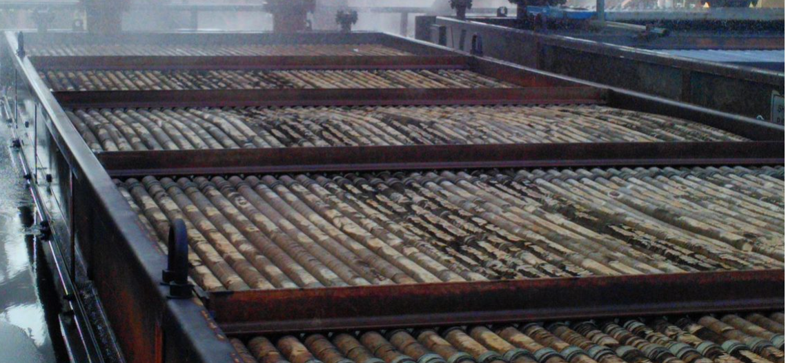
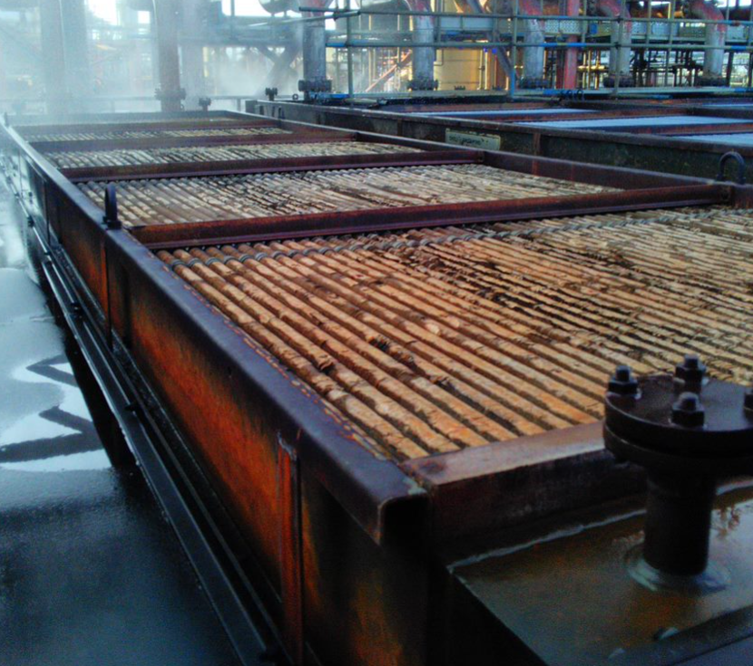
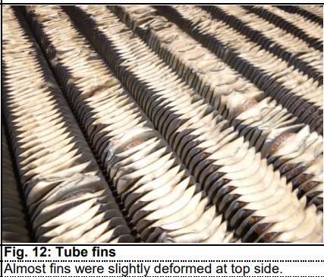
E9207 aircooler overview
Top row finned tube bowing
Suspected there since 2008
Damaged finned tubes will be hotter causing more tubes expansion
  Service: Mild Vacuum Column MCR (Kerosene)
  Temperatures, Inlet: 150-180degC / Outlet: 50-150degC
  Pressure: 3.5 barg

Slide 5
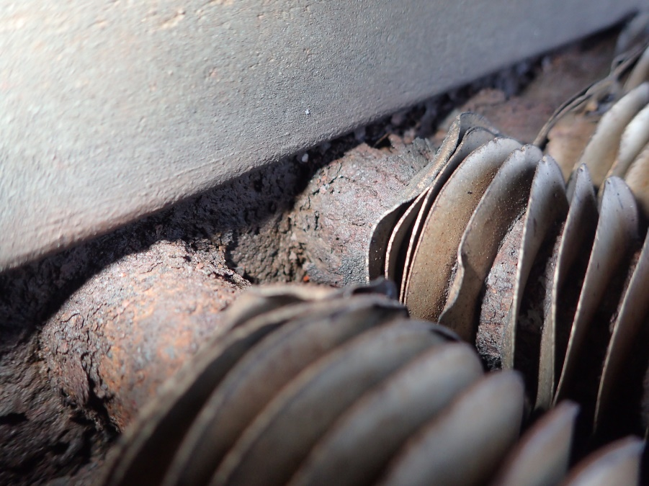
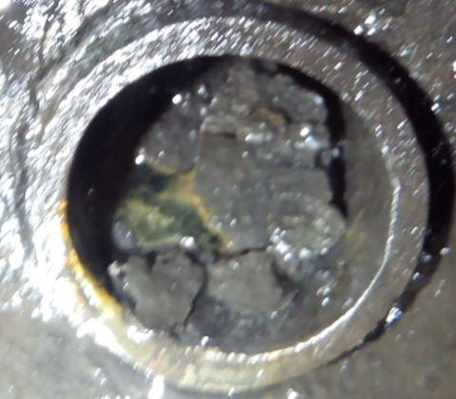
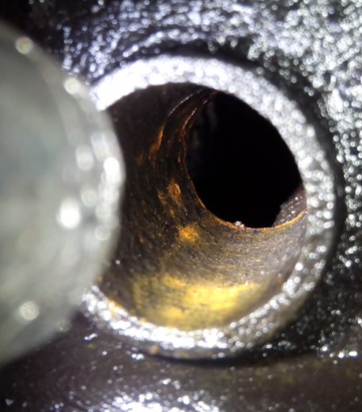
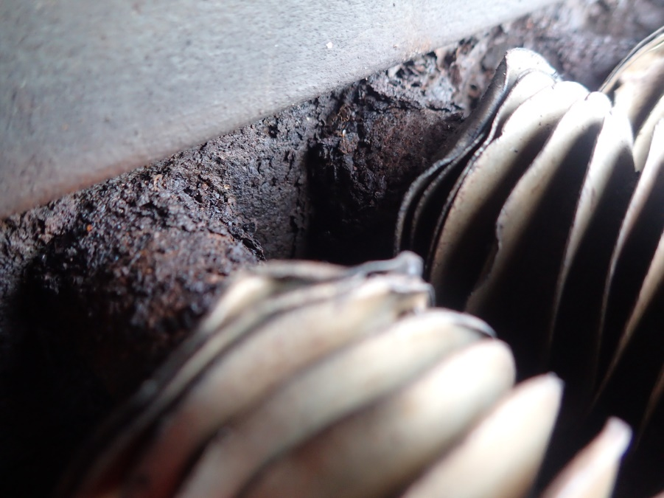
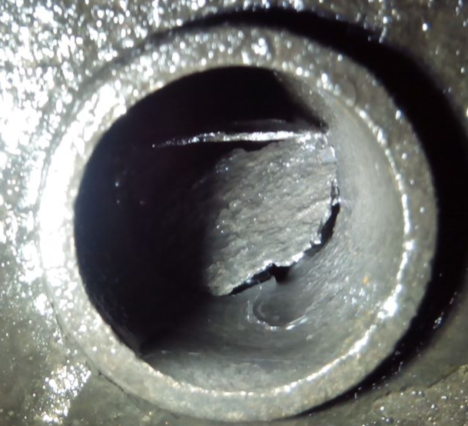
E9207 tubes condition
Tubes internal found with internal deposits and scales
Observed one tube completely sheared off

Slide 6
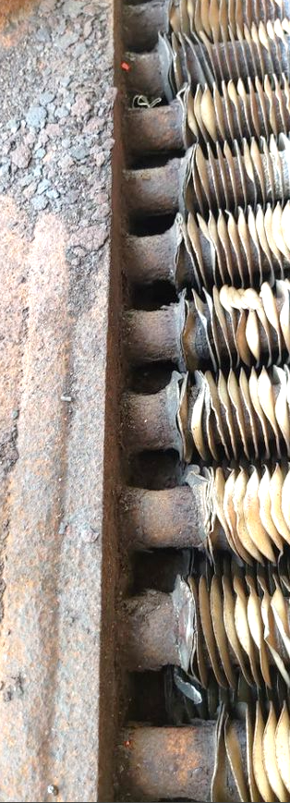
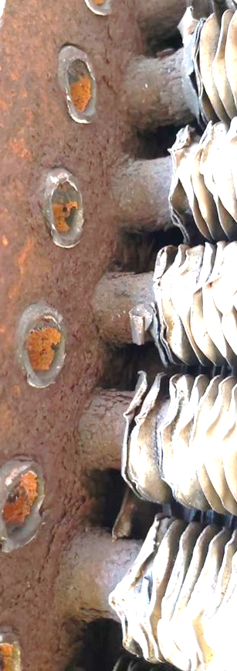
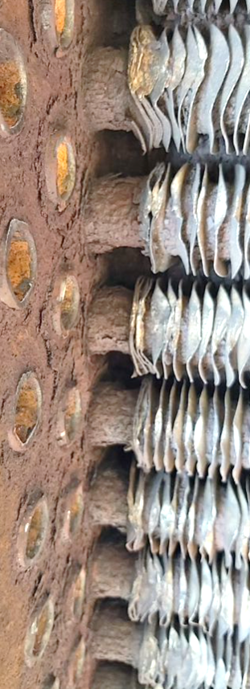
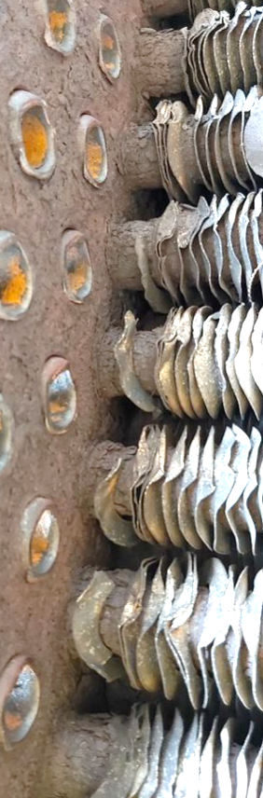
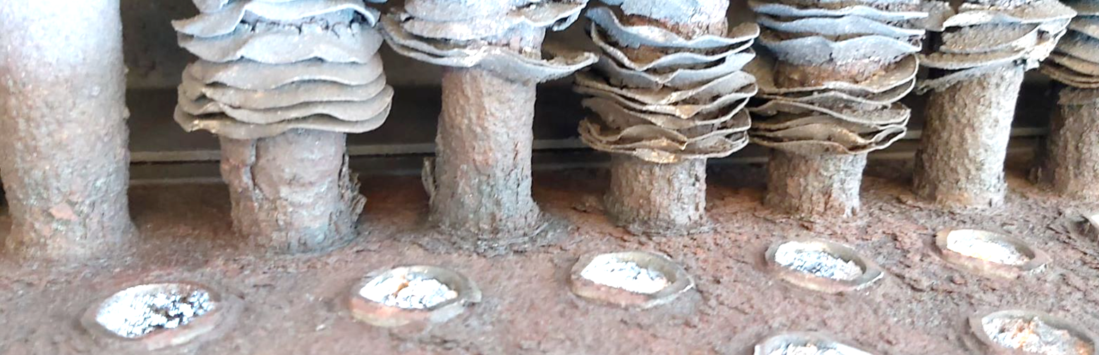
E9207 aircooler first look
1st Row
2nd Row
3rd Row
4th Row
5th Row

Slide 7
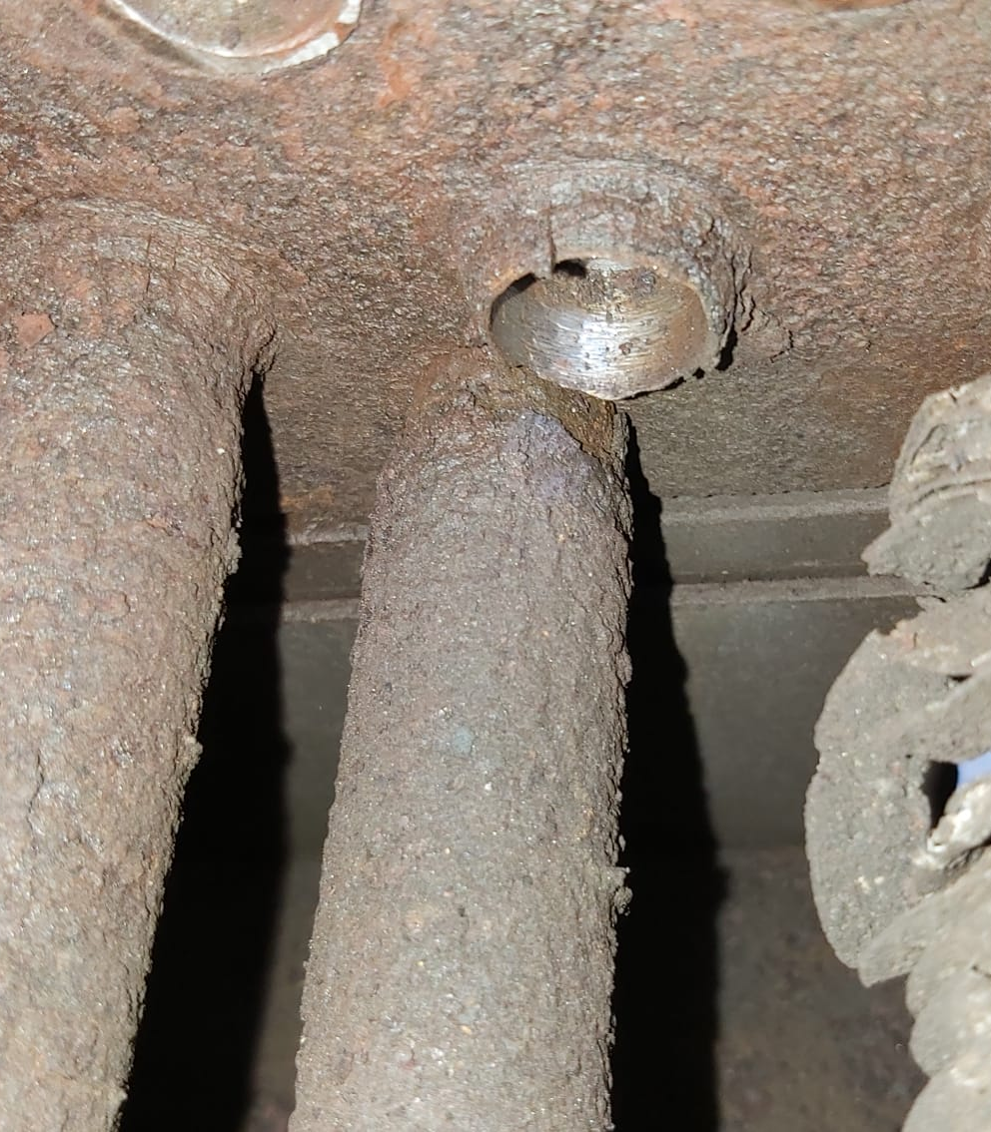
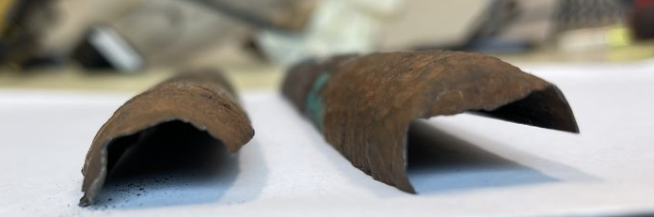
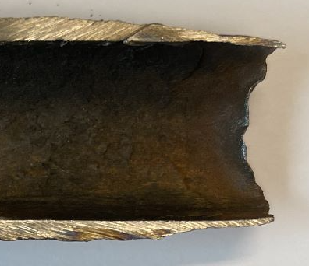
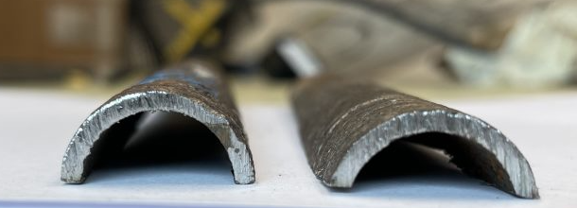
E9207 Leaked Tube
Inlet Tubesheet
<0.4mm
2. Tube profile at sheared end (near tubesheet)
Sheared tube
2.2mm
1. As found tube
3. Tube profile away from sheared end
4. Thickness loss from OD
  Leaking tube was found completely sheared at inlet tubesheet.
  Severe localized external corrosion was observed on the tube OD adjacent to inlet tubesheet. Internal corrosion was negligible.
  Remaining tube thickness adjacent to sheared face was <0.4mm as compared to 2.2mm away from sheared face.

Slide 8
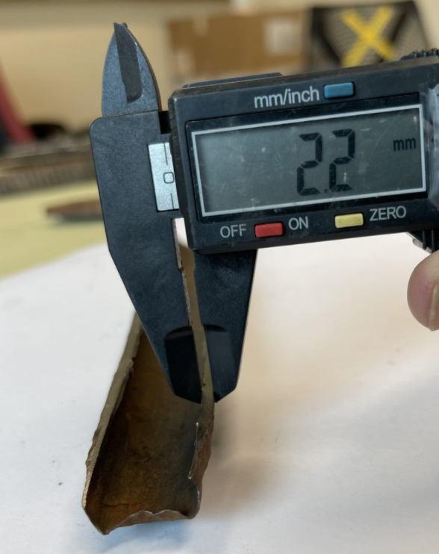
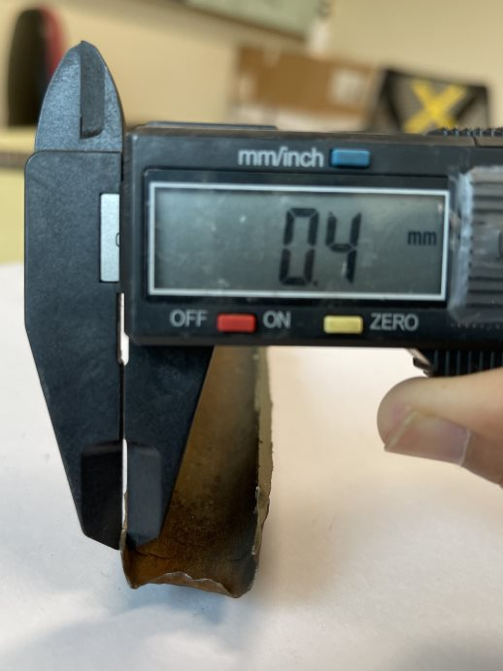
E9207 Leaked Tube
5. Thickness away from sheared face
6. Thickness adjacent to sheared face

Slide 9
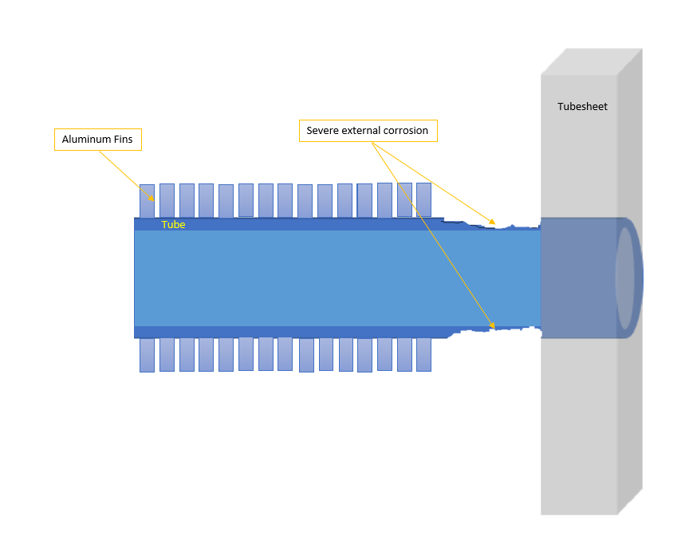
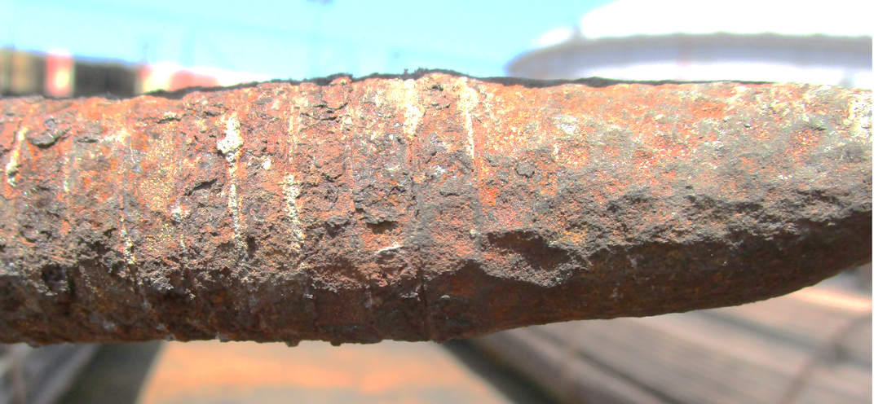
Corrosion Mechanism
  External Atmospheric Corrosion over long term
  Long Term Corrosion Rate, 2.2mm lost in 38 years = 0.06mm/year
  Corrosion rate looks reasonable in terms of atmospheric corrosion for marine environment
  External aluminium fins also acts as a sacrificial galvanic couple for carbon steel tube hence prevents corrosion at finned section
  Therefore, tube ends are more prone to external atmospheric corrosion

Slide 10
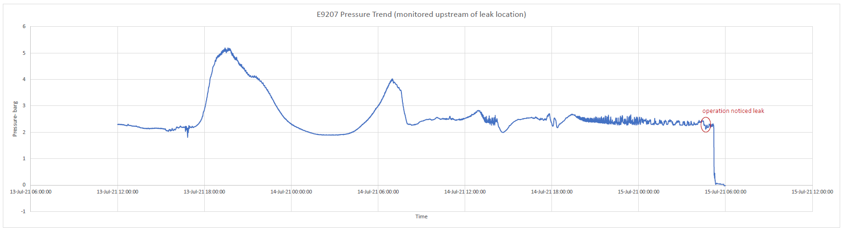
Leak
Pinhole must have been appeared first before the complete rupture/shearing of the tube
Corrosion scales might have prevented any noticeable leak
Leak through the pinhole during start-up might have loosened the corrosion scales resulting in overstressing of already thinned down tube which finally sheared under internal pressure and deadweight

Slide 11
Inspection
2

Slide 12
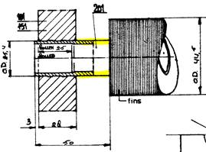
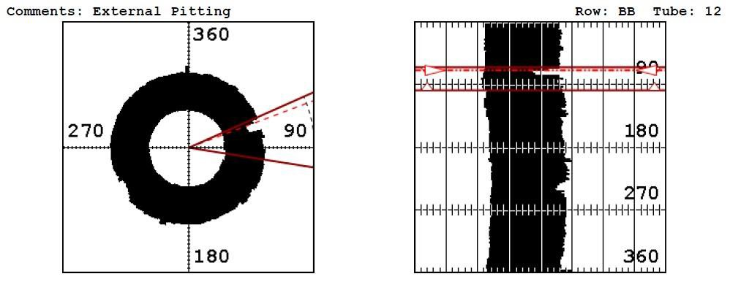
Inspection
Tubes that are enclosed in fins cannot be inspected from exterior. Best methods for inspecting tubes are IRIS (internal rotary inspection system)
This technique require UHPJ and thoroughly cleaned before any method is effective
In the current inspection technique, the bare finned section becomes a dead zone with ECT and IRIS.
External visual inspection of the bare finned section would require access from the top and bottom of the ACHE without obstruction (for instance, the raditor louvers in the case of E9207)

Slide 13
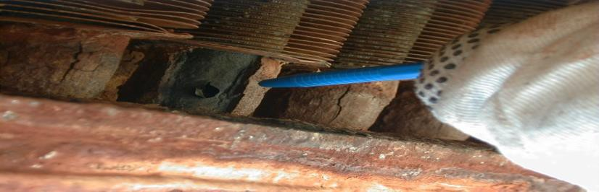
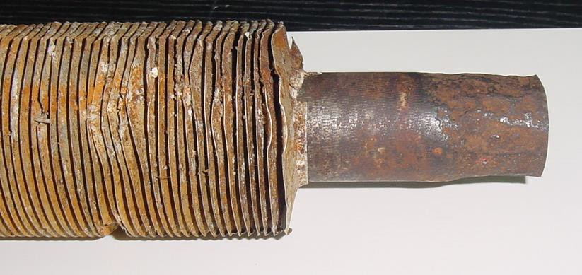
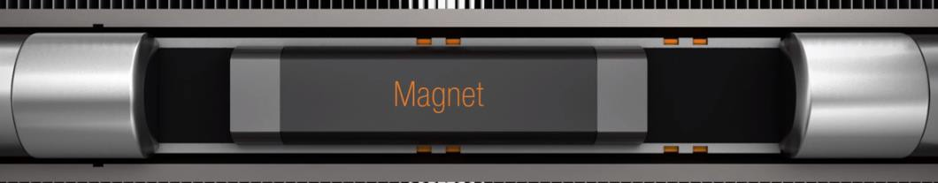
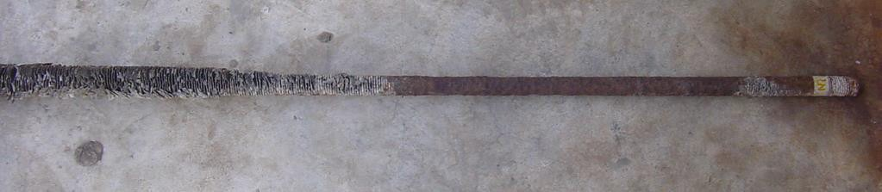
Inspection
New technique specially designed for such external corrosion mechanism (not tested in Bukom but trials were successful in Upstream)
A custom probe head was designed wherein both the MFL and PSEC technique could be performed in one single pass.
The probe is sensitive to both ID & OD defects and further its unique design enables the detection of corrosion that usually happens in the unfinned section of the tubes in a fin fan cooler tube bundle. The unfinned section is usually around 20 to 30mm long and just after the tube sheet.
MFL + PSEC (Magnetic Flux Leakage + partial saturated eddy current)
From the trial it is recommended to carry out 100% screening in all tubes using MFL+PSEC probe and followed by checks with IRIS

Slide 14
HCU ACHE data and Bukom experience
3

Slide 15
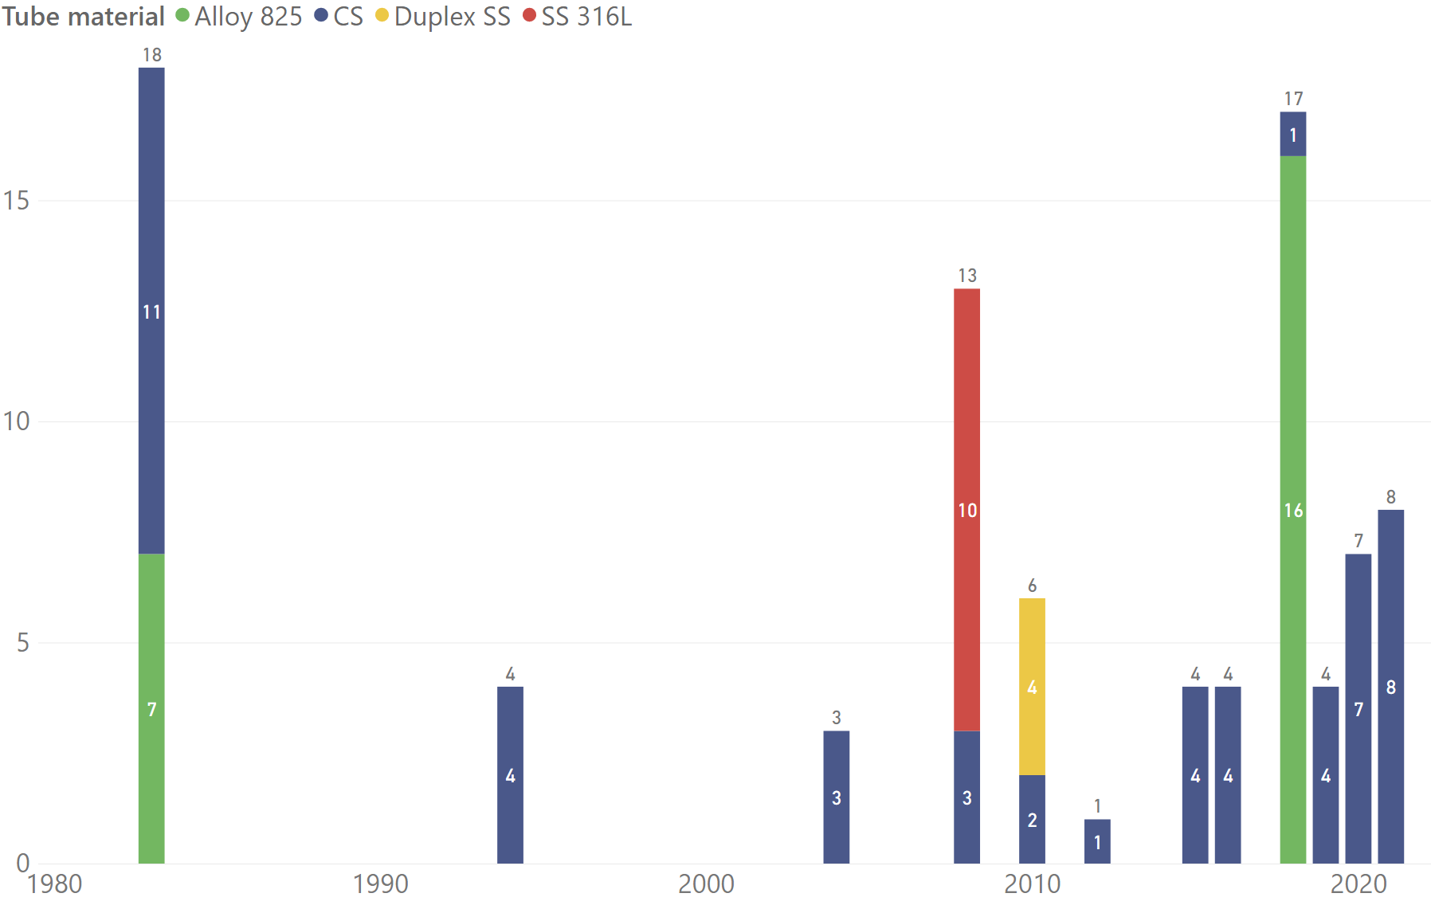
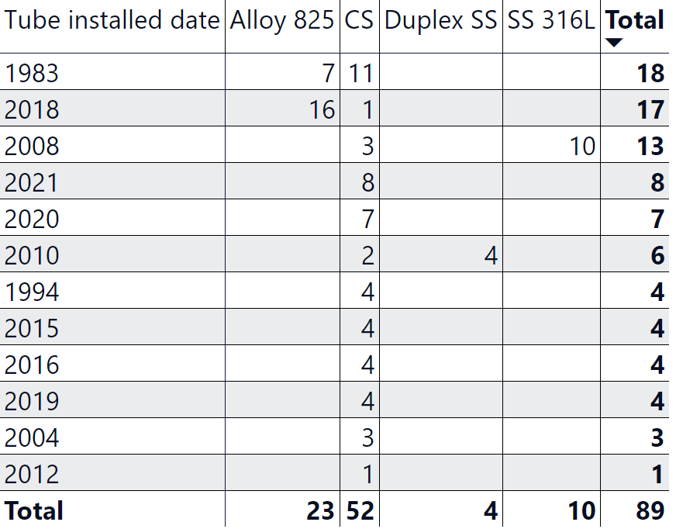
HCU ACHE data
Alloy 825: E9412 absorber feed gas coolers series and E7902 stripper overhead
Duplex SS: E6251A/B lean solvent and E6253A/B acid gas condenser
SS316L: E9416- 1 to 10 lean Sulfinol cooler

Slide 16
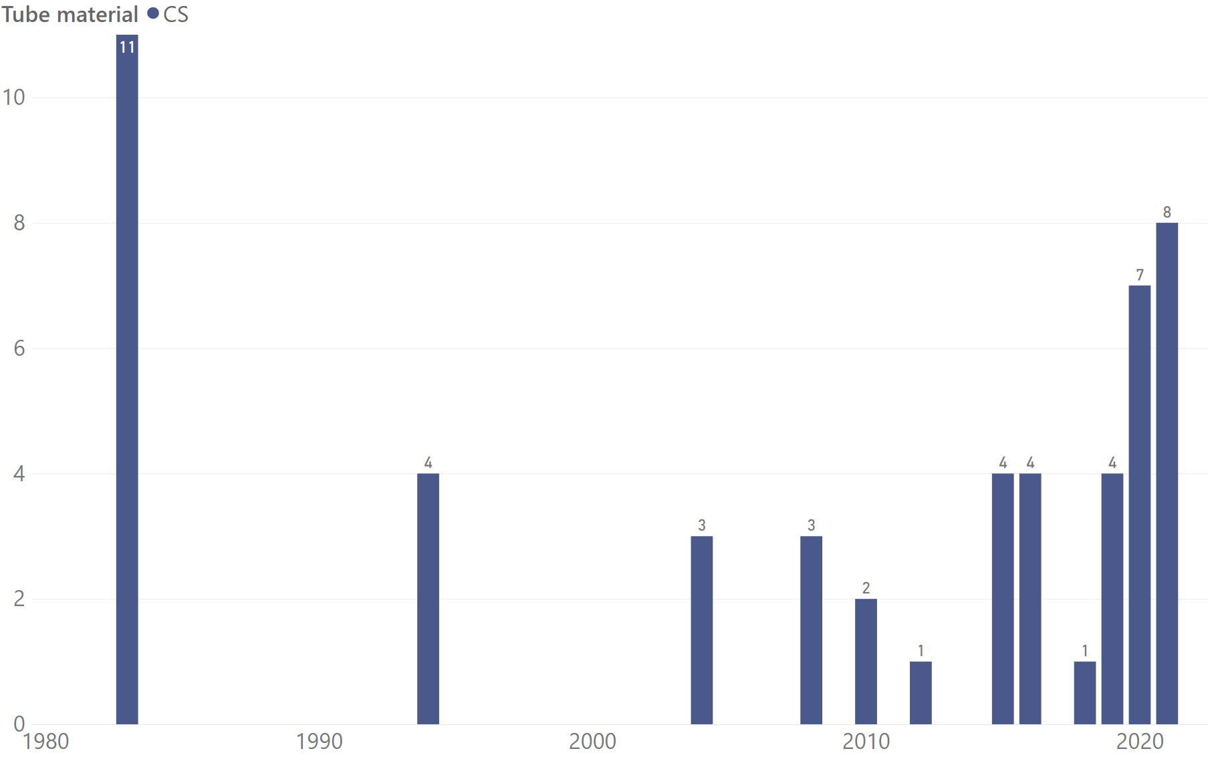
HCU ACHE data- CS tubes
15 ACHE with >20 years life
8 ACHE between 10 to 20 years life
29ACHE with <10 years life
Identified the following for inspection:
15 ACHE with > 20 years life+ selected 6 ACHE with 15 years life (21 ACHE in total)
External inspection from the top and bottom for assessment of current external visual condition (priority set from P1 to P2)
HV4 ACHEs to assess for opening up for tube testing since HV4 shutdown
ACHE with indications of external corrosion to be assess with PUDT for isolation feasibility

Slide 17
HCU ACHE data- CS tubes- 24
Equipment ID | Description | Unit | Tube installed date
E9004-1 (PBU) | E9004-1, TOP CIRCULATING REFLUX COOLER | S901-HCU-9000 | 1983
E9004-2 (PBU) | E9004-2, TOP CIRCULATING REFLUX COOLER | S901-HCU-9000 | 1983
E9006A (PBU) | E9006A, DISTILLATE COOLER | S901-HCU-9000 | 1983
E9010-1 (PBU) | E9010-1, TEMPERED WATER COOLER | S901-HCU-9000 | 1983
E9010-2 (PBU) | E9010-2, TEMPERED WATER COOLER | S901-HCU-9000 | 1983
E9010-4 (PBU) | E9010-4, TEMPERED WATER COOLER | S901-HCU-9000 | 1983
E9206-1 (PBU) | E9206-1, MILD VACUUM TOP C/R COOLER | S901-HCU-9200 | 1983
E9206-2 (PBU) | E9206-2, MILD VACUUM TOP C/R COOLER | S901-HCU-9200 | 1983
E9220 (PBU) | E9220, MILD VACUUM TOP C/R COOLER | S901-HCU-9200 | 1983
E9603 (PBU) | E9603, HDT STRIPPER O/H CONDENSER | S901-HCU-9600 | 1983
E9701 (PBU) | E9701, L.P. CONDENSATE COOLER | S901-HCU-9700 | 1983
E9208-1 (PBU) | E9208-1, KERO COOLER | S901-HCU-9200 | 1994
E9208-2 (PBU) | E9208-2, KERO COOLER | S901-HCU-9200 | 1994
E9223-1 (PBU) | E9223-1, GAS OIL COOLER | S901-HCU-9200 | 1994
E9223-2 (PBU) | E9223-2, GAS OIL COOLER | S901-HCU-9200 | 1994
E9211A (PBU) | E9211A, HYDROWAX AIR COOLER | S901-HCU-9200 | 2004
E9211B (PBU) | E9211B, HYDROWAX AIR COOLER | S901-HCU-9200 | 2004
E9211C (PBU) | E9211C, HYDROWAX AIR COOLER | S901-HCU-9200 | 2004
E9114 (PBU) | E9114, FRESH GAS COMP 1ST STG INTERCOOLR | S901-HCU-9100 | 2008
E9115 (PBU) | E9115, FRESH GAS COMP 2ND STG INTERCOOLR | S901-HCU-9100 | 2008
E9117 (PBU) | E9117, FRESH GAS COMP 3RD STG INTERCOOLR | S901-HCU-9100 | 2008
E7903-1 (PBU) | E7903-1, STRIPPED WATER R D COOLER | S901-HCU-7900 | 2010
E7903-2 (PBU) | E7903-2, STRIPPED WATER R D COOLER | S901-HCU-7900 | 2010
E9704 (PBU) | E9704, STEAM CONDENSATE COOLER | S901-HCU-9700 | 2012

Slide 18
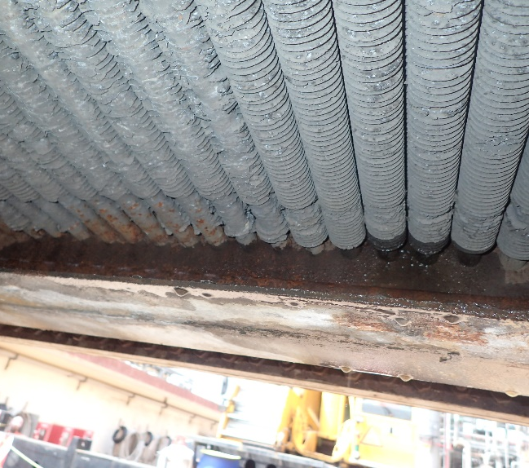
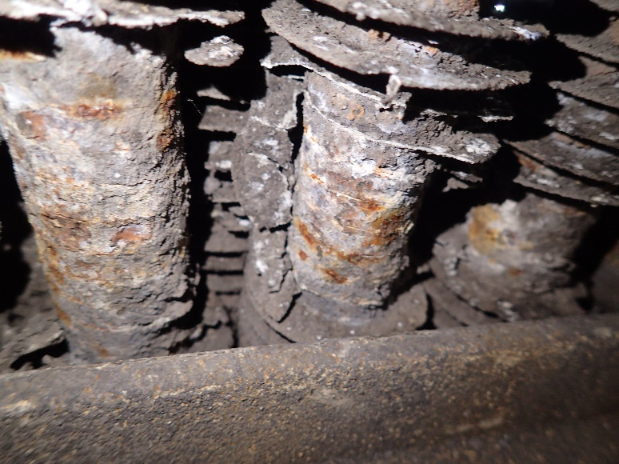
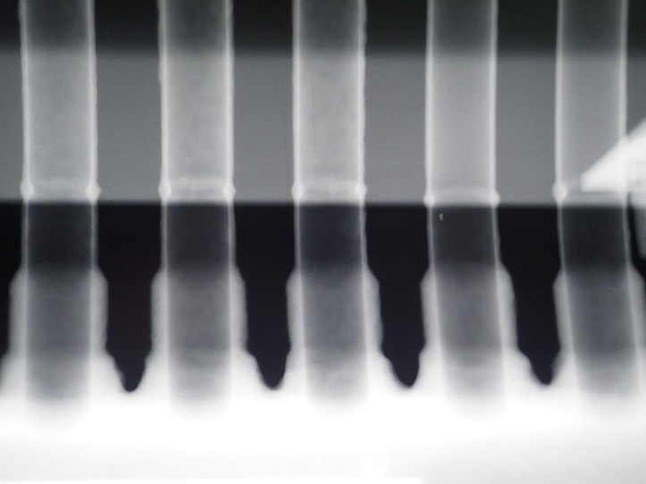
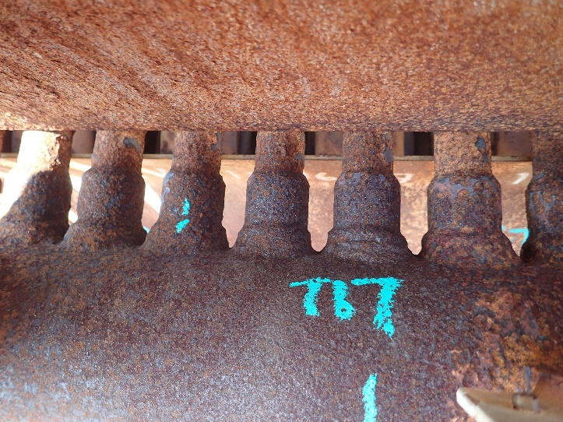
Bukom experience
CD5 2016 TA E8530-2 leaked due to external corrosion at bare section
  As part of the investigation, 14 ACHE were identified for a thorough close visual inspection from the cowling and 11 were identified with corrosion and planned for replacement in next TA. Out of which, 3 were identified for hydrotest to ensure they last till the next TA.
PLAT4 2021 E9904 paper thinned tubes at the unfinned section in 2021.
  ACHE isolated and planned for re-tubing

Slide 19
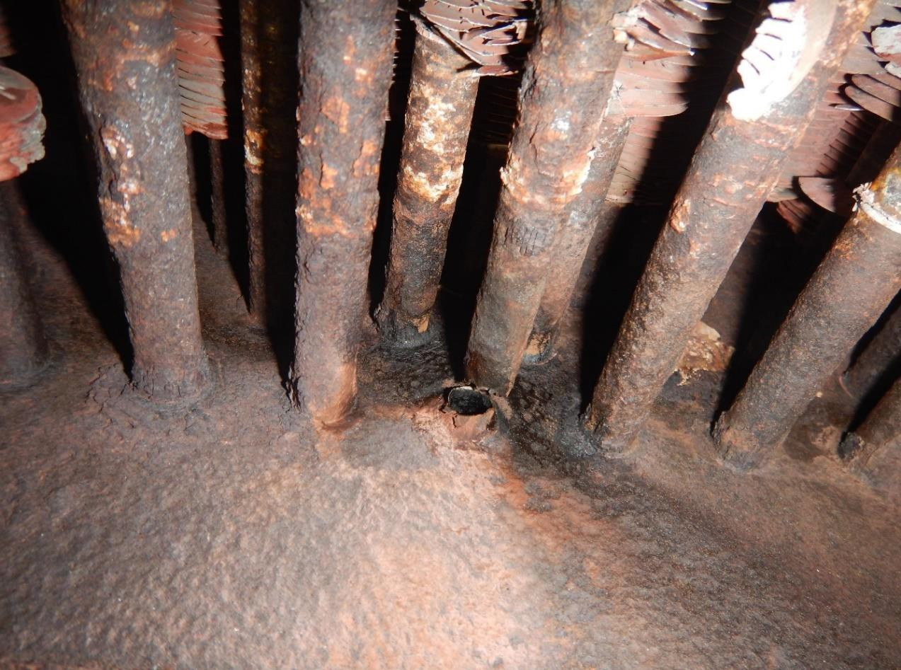
Operating Experience (Ursa HAL-1062)
Ursa Platform, Gulf of Mexico (Marine Environment).
HAL-1062 (2nd Stage Discharge Cooler for Field Gas Compressor-2).
Tube rupture on November 25, 2020.
Tubes: 0.625” OD x 0.083” wall (A-179 with L-footed Fins).
Exposed tube ends coated with a Phenolic coating.
MAWP = 2200 psig, t_{min} = 0.049 inches (Available CA = 0.034 inches).
Gas inlet temperature ~305 °F, intermittent service.
ACHE installed new in 1999.
Tube thickness at the rupture site was ~0.015 inches. (0.375mm)
◼ Corrosion Rate = (0.083 - 0.015)/21 = 3.2 mpy.
Corrosion rate calculation assumes the coating failed immediately after the
ACHE was placed in service.
Localized external corrosion at a few tubes in the bottom row.
Tube rows 1, 2, and 3 with significantly less wall loss.

Slide 20
Discipline Asset Strategy- MMI
4

Slide 21
Discipline Asset Strategy- Mechanical
Heat Exchanger Bad Actor list/ Site LOPC List
    To study the individual PU Heat Exchanger Bad Actor List to understand the cause of leak
    To implement any modification/ work scope required in TA (i.e. flange face machining, gasket modification, bolt material modification)

Slide 22
Inspection –Scoping
Scheduled Inspection
Heat Exchanger:
    Heat exchanger tube bundle with last inspection date >15 years ago to plan for tube testing with minimum 50% coverage
    Heat exchanger tube contingency plan 15% tubes of the heat exchanger tube metallurgy
    Aircooler heat exchanger scope for (CS and low alloy tubes) :
        ACHE < 10 years must be external visual inspected focused on the bare finned tubes segment from the accessible location
        ACHE > 10 years must be subjected to close visual inspection including the bottom rows of tubes AND/OR subjected to tube testing technique capable of detecting tube external corrosion next to header(PSEC + MFL?) 100 %
        ACHE >20 years must be going for retubing (This is to minimise discovery during TA)

