Slide 1
BOT Meeting: Jan 2022
SMPO catalyst procurement and development forum
Vivian Nassar, Kaushik Basak, Vikram Bhide
Shell
21 January 2022

Slide 2
Agenda
Business Challenge
Update/Sequence of Events
Road Map U600
Proposal
Road Map U800
Discussion points
21 January 2022

Slide 3
Business Challenge
Security of supply for U600 (Styrene) post BASF sale of De Meern site
  Highlight the risks
  Agree plan for mitigation of risks
Security of supply for U800 (MPK hydrogenation) post BASF discontinuation and Clariant plant move
  Highlight the risks
  Agree plan for mitigation of risks
21 January 2022

Slide 4
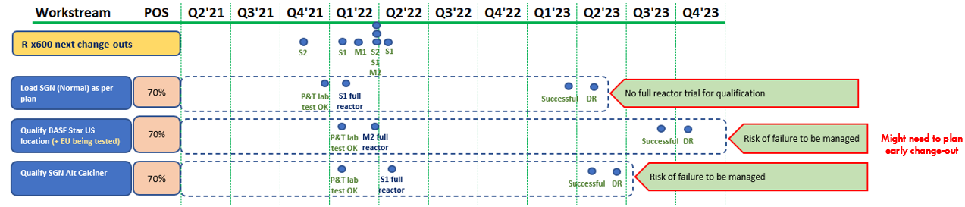
Update/ sequence of events since last BOT meeting
BASF catalysts (US Calc 1, US Calc 2) received on15th Oct’21, catalyst safety assessment & performance tests (with same feed) completed in mid Dec’21 → Sub-optimal performance, shared with DRB, BOT, BASF (ELLBA support for US Calc 2)
BASF (EU) catalyst testing in progress (till 3rd SEQ out of 6 SEQs) → Results shared in this slide pack
PO issued to SGN for SGN/Norpro 2nd calciner (D) qualification at SJI
DRB support for full reactor loading conditional qualification tests
    MSPO2 R4601B (week12, mid Mar’22) → BASF Star catalyst (US Calc 2/ EU), subject to successful PCR
    SMPO1 R4601C (week14, 2022, early Apr’22) → Norpro alt calciner D catalyst, subject to successful PCR
21 January 2022

Slide 5
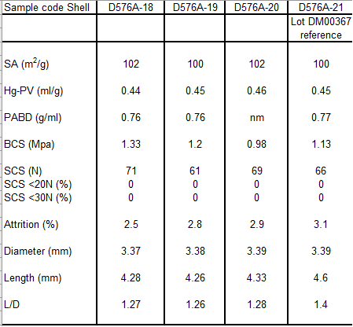
Summary: CoA, Acid Test & CSA (A18, A19: Star US; A20: Star EU; SGN)
CoA (received from BASF)
Acid test results
Lot no | Fresh Cat BCS (MPa) | Acid test BCS (MPa)
268 (STCB Ref) | 1.55 | 1.40
A-18 (US Calciner 1) | 1.61 | 1.60
A-19 (US Calciner 2) | 1.57 | 1.45
A-20 (EU) | 1.63 | 1.68
Norpro Alt Calciner | 1.68 | 1.72
Catalyst Safety Assessment (CSA) Test: no abnormality for A18, A19, A20, SGN Alt Calc RHA data (against reference Star catalyst). Work in progress for formal TA2 (CSA) approval
Conclusion: Star & SGN alt calc catalysts CoA, Acid Test, CSA meet P&T requirements for qualification
21 January 2022

Slide 6
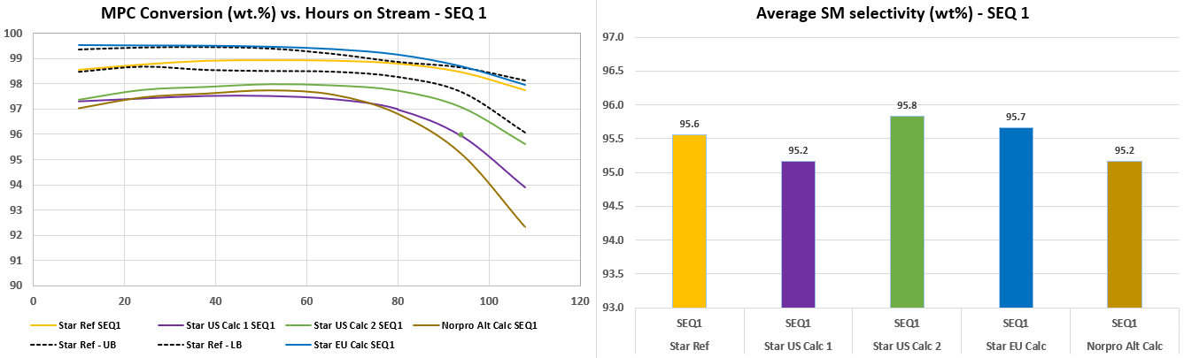
Summary: Star & Norpro Multi Seq (MSQ) test performance – SEQ 1
Activity (MPC conv): Star EU cat ~ Reference> Star US Calc 2 > Star Calc 1 & SGN Alt Calc
Very high activity of Star EU cat implies that post “C” burn-off data (SEQ 6) performance is crucial
SM selectivity comparable (within ~ 0.5 w% of reference for all catalysts)
21 January 2022

Slide 7
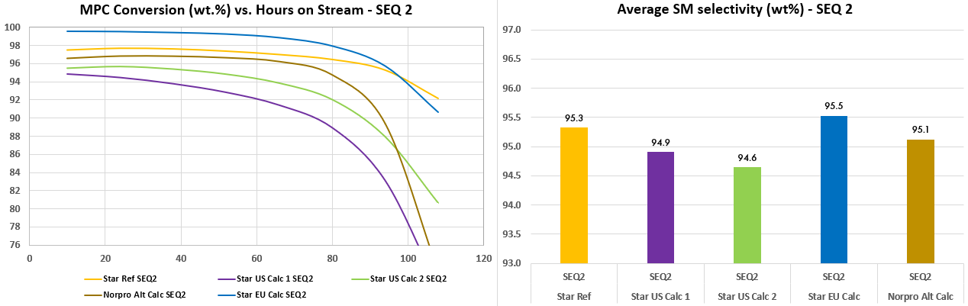
Summary: Star & Norpro Multi Seq (MSQ) test performance – SEQ 2
Activity (MPC conv): Star EU cat > Reference > SGN Alt Calc > Star US Calc 2 > Star Calc 1
Star EU catalyst continues to have the highest activity (in terms of MPC conversion) among the tested catalysts
SM selectivity comparable (within ~ 0.5 w% of reference for all catalysts), except Star US Calc 2 (lower)
21 January 2022

Slide 8
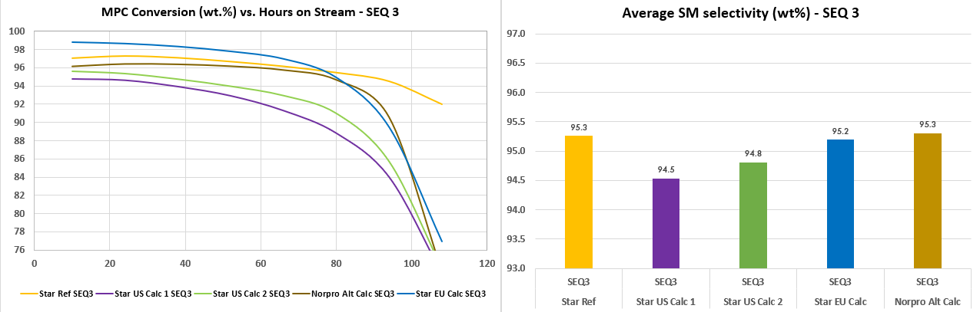
Summary: Star & Norpro Multi Seq (MSQ) test performance – SEQ 3
Activity (MPC conv): Reference > Star EU cat > SGN Alt Calc > Star US Calc 2 > Star Calc 1
SM selectivity comparable (within ~ 0.5 w% of reference for all catalysts), except Star US Calc 1 (lower)
For EU Star cat, average SM selectivity till SEQ 3 matches with that of Star reference catalyst.
21 January 2022

Slide 9
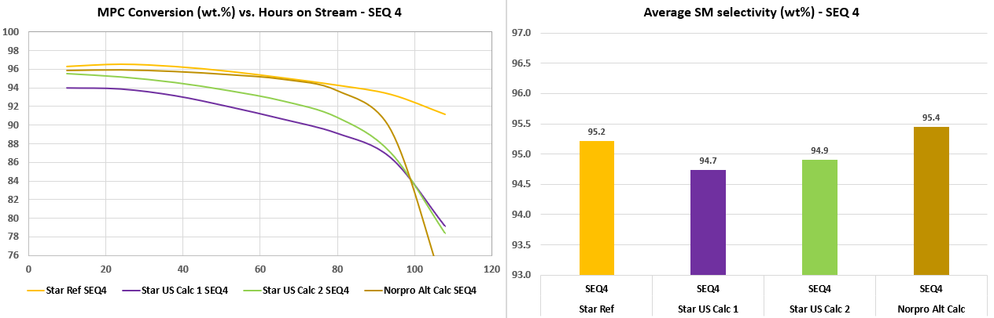
Summary: Star & Norpro Multi Seq (MSQ) test performance – SEQ 4
Activity (MPC conv): Reference > SGN Alt Calc > Star US Calc 2 > Star Calc 1
MPC conversion continues to follow the 3rd SEQ trend, with higher deterioration for Star US Calc 1
SM selectivity comparable (within ~ 0.5 w% of reference for all catalysts)
Data awaited for Star EU catalyst (run in progress, to end last week of Jan’22, working team meeting 31Jan)
21 January 2022

Slide 10
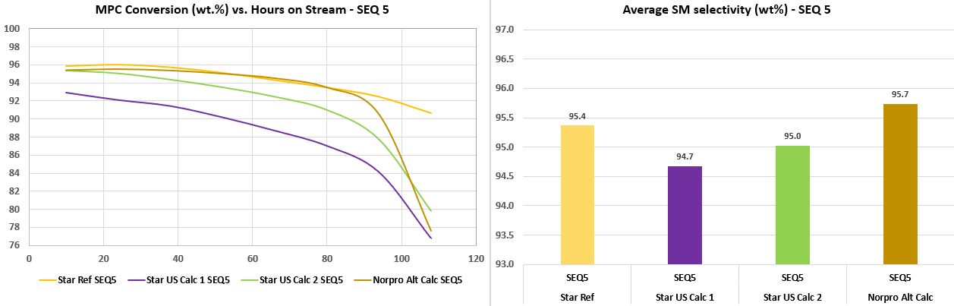
Summary: Star & Norpro Multi Seq (MSQ) test performance – SEQ 5
Activity (MPC conv): Reference > SGN Alt Calc > Star US Calc 2 > Star Calc 1
MPC conversion continues to follow the 4th SEQ trend, with higher deterioration for Star US Calc 1
SM selectivity comparable (within ~ 0.5 w% of reference for all catalysts) except Star UC Calc 1 (lower)
21 January 2022

Slide 11
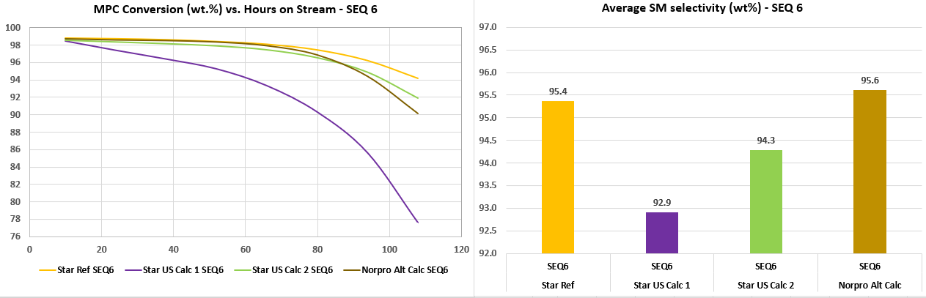
Summary: Star & Norpro Multi Seq (MSQ) test performance – SEQ 6
Activity (MPC conv) post “C” burn-off acceptable and almost at par for all catalysts except Star US Calc 1
SM selectivity lower by ~ 2.5 w% for US Calc 1, > 1 w % for US Calc 2 (both higher than 0.5 w%)
Avg SM selectivity of Star cat US Calc 1 is also “significantly” lower than Star reference catalyst
Avg SM selectivity of SGN alt calciner is at par with Star reference catalyst
SM sel, w% | Star Ref | Star USC1 | Star USC2 | Norpro
Avg 6SEQ | 95.35 | 94.49 | 94.92 | 95.40
Delta Ref |  | -0.86 | -0.43 | 0.05

Slide 12
Priorities and Qualification Scenarios
Priority | Scenarios | Site for full load, timing | Comments
1 | Qualify (BASF Site 1, USA), or (BASF Site 2, EU)* | M2 (R-4601C), Mar’22 | A19, i.e. Calciner 2 (US) or A20 (EU) - catalyst testing in progress, results will be available on 31st Jan’21
2 | Qualify SGN alt calciner D, 100% SGN** | S1, R-601C Apr’22 | PO released, representative catalyst to be tested at STCB during w1 Feb – mid Mar’22. Decision on loading based on the outcome.
* Note: By 31stJan’22, Shell will have results of A20.
    Scenario 1: A20 > A19 → Moerdijk to load A20
    Scenario 2: A19 > A20 → Moerdijk to load A19, requires air shipment
    If US Calc 2 (A19) is procured, Moerdijk might need to partly/ fully pay the air shipment (discussion in progress)
BASF will ensure that catalyst reached Mdk by early Mar’22
** If the catalyst performance in STCB is worse than the earlier results, SGN will give full credit note to Shell for the equivalent quantity of catalyst, no plant trial. If it matches the earlier performance, SMPO-1 to load the same in Apr’22.
21 January 2022

Slide 13
Conclusions - U600
On track qualification by loading full reactors (post successful lab qualification) for both BASF & SGN → security of supply, Target M2 & S1
Priorities, constraints and action plans agreed (Slide No. 12)
Discontinuation of all acid tests till end Q1’2022 (sites have been notified of the situation) to support the qualification
Request for management support on accurate forecasting for 2022/2023
Seek senior management support (business) to negotiate a higher volume from De Meern plant in 2022 ( to cover at least ½ of 2023 (~100 tons as a min) → work in progress
21 January 2022

Slide 14
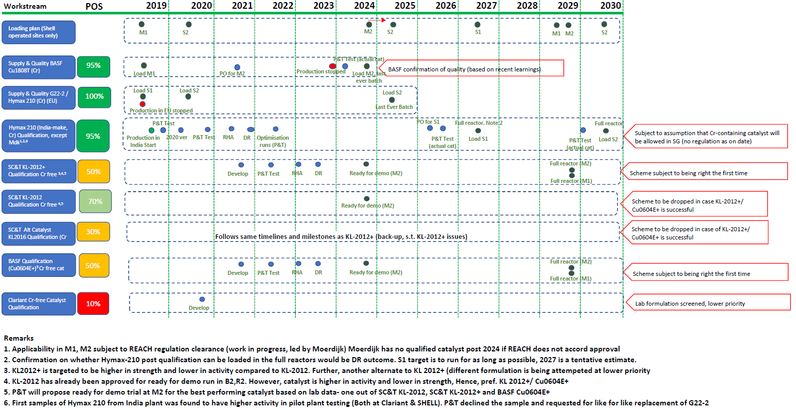
U800 Catalyst Roadmap (Shell SMPO sites)

Slide 15
Discussion Items
DR for Hymax-210 issued: Clariant catalyst (Hymax-210) approved for all sites
Any update from Moerdijk on REACH sign-off for usage?
21 January 2022

Slide 16
Discussion and Q&A

Slide 18
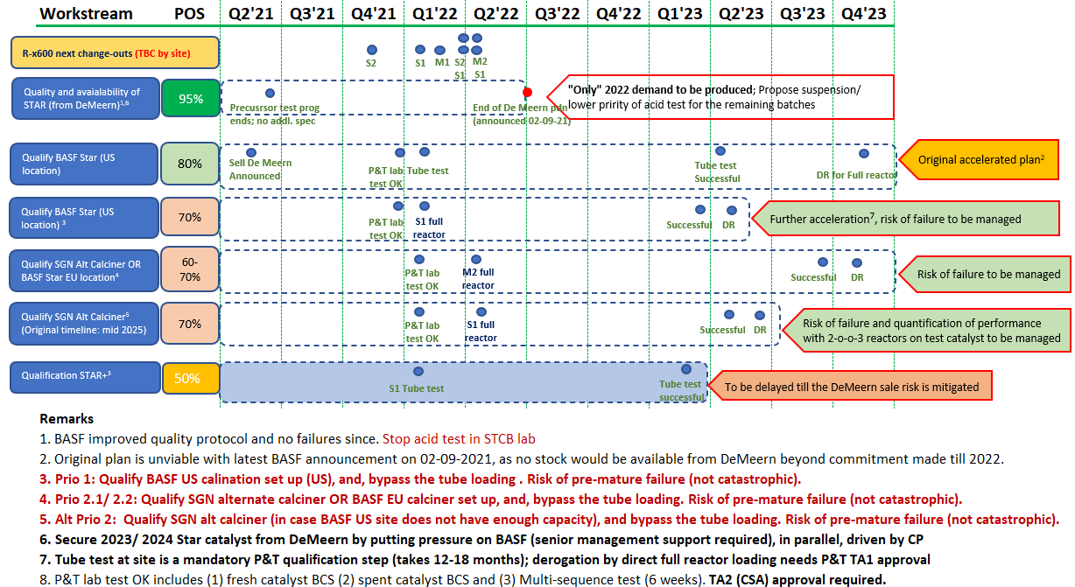
U600 Roadmap (Shell SMPO sites) – Accelerated Plan (Proposal)
20 October 2021

Slide 19
Update/ Sequence of events : BASF De Meern Sale & SGN Limitation
BASF announced on 06-05-2021 their intent to sell De Meern site (Star cat production site)
Star Catalyst production will remain in their strategic portfolio
BASF looks at Shell for full support in approval of cat from 2 sites (USA:100% BASF, EU: likely not 100% BASF)
Working committee set up to manage info and actions during transition (Vivian & Kaushik and 2 BASF members)
SGN is unable to produce more than 210 MT/a catalyst, pending qualification alternate calciners (100 % SGN)
Shell current Forecast for Styrene Catalyst (U600)
*Forecast offtake per year now around-450 mt due to C2 coming onstream (CSPC). SGN/ Norpro can only deliver 208 tons it is reasonable to assume a demand for BASF ~250 mt pa
Site in ton pa BASF | Forecast 2022 | Forecast 2023* | Forecast 2024*
SJI | 56 | 22 | TBC
Moerdijk | 57 | 78 | 92
CSPC | 105 | 132 | 132
Total | 218 | 232
Site in ton PA SGN | Forecast 2022 | Forecast 2023 | Forecast 2024
SJI | 118 | 111 | TBC
Moerdijk | 22 | 44 | 22
CSPC | 68 | 68 | 85
Total | 208 | 223
Total Demand | 426 | 455 | TBC
20 October 2021

Slide 20
Request for steer
Stop acid test of Star cat batches:
  BASF was not able to recreate the hold samples and closes the item as solved as product on spec
  Challenges on testing facilities needed for qualification runs
Catalyst supply Issues U600 take priority: Shortage of catalyst after 2022,until approval of new site
    Agreement on shortening existing testing protocol
    Do we seek financial risk sharing/compensation from BASF/ SGN in the event of failure
    Push to increase the amount reserved for Shell in 2022 from De Meern
Agreement from Sites: support for full reactor qualification of catalysts based on the proposals
Quantify Loss to the SMPO business due to shortage
  ½ year no catalyst : ?
  1 year no catalyst: ?
20 October 2021

Slide 21
Implications
Results till SEQ 2 shared with BASF last week (working team meeting), with a request for escalation to BASF senior management to re-evaluate the possibility of more stocks from De Meern. BASF does not foresee any obvious solution to resolve the sub-optimal performance (based on their internal tests) in the short run.
Discussion initiated with the sites on operational handles to mitigate the potential impact: to report back to DRB.
Though SJI gave in-principle approval for loading full reactors [R-601A (Feb’22) & R601C (Apr’22)] for the plant trials, we propose to use only 1-o-o-2 reactors to manage uncertainties.
Risk sharing with BASF by proposing full reactor trial of Star catalyst (US) at MSPO2 & in parallel to Norpro (alt calciner) qualification at SMPO1.

Slide 22
Impact of MSQ test results: risks and mitigations on plant trial
DRAFT
Risks | Mitigations | Remarks
Lower conversion More MPC recycle, incremental energy for C-x602 Feed to C-x602 will have more MPC, leading to slight increase of MPC in side stream to U-x100 C-x605 level rises faster towards end of the sequence, requiring operator attention on BC-x605 level control (possibility of LZ-HH trip) Higher MPC in U-x800 feed Higher MPC in crude SM Precursor tank inventory management | Not exp to be a major issue C-602 optimisation should be able to handle More frequent EB washes Not exp to be a major issue Can be handled by U-x700 To be discussed | NA Study Cx602 control & impact on U-x100 Discussion with ops R-x801 RIT marginal increase (reversible ?)
Lower SM selectivity Higher EB:SM ratio Higher backpressure (owing to more HE make) | No operational handle | Economic loss
Sub-optimal performance after Carbon burn off (data awaited) → lower cumulative SM make, lower run length | Next batch of catalyst should be available at site | Capex constraints

