Slide 1
SM catalyst trials
Ong Lih Ren

Slide 2
Agenda
Business Challenge
Background
Road Map U600
Proposal
Risks

Slide 3
Business Challenge
Two catalyst suppliers for SM catalyst: BASF (Star cat); SGN (Norpro)
Security of supply for Star cat post BASF sale of De Meern site
  Urgency to confirm new catalyst production by end 2022
  Highlight the risks
  Agree plan for mitigation of risks

Slide 4
BASF De Meern Sale & SGN Limitation
BASF announced on 06-05-2021 their intent to sell De Meern site (current Star cat production site)
  Star Catalyst production will remain in their strategic portfolio
  No volume in 2023, pending qualification of alternate calciners (USA:100% BASF, EU: likely not 100% BASF)
SGN is unable to produce more than 210 MT/a catalyst, pending qualification of alternate calciner (100% SGN)
According to the forecast and the timing proposed in the following roadmap – anticipated shortfall
of MPC dehydration catalyst in 2023 – 2024 demand of ~250 MT/a
Shell current Forecast for Styrene Catalyst (U600)
*Forecast offtake per year now around ~450 mt due to C2 coming onstream (CSPC). SGN/Norpro can only deliver 208 tons, it is reasonable to assume a demand for BASF ~250 mt pa
Site in ton/a BASF | Forecast 2022 | Forecast 2023* | Forecast 2024*
SJI | 56 | 22 | TBC
Moerdijk | 57 | 78 | 92
CSPC | 105 | 132 | 132
Total | 218 | 232
Site in ton/a SGN | Forecast 2022 | Forecast 2023 | Forecast 2024
SJI | 118 | 111 | TBC
Moerdijk | 22 | 44 | 22
CSPC | 68 | 68 | 85
Total | 208 | 223
Total Demand | 426 | 455 | TBC

Slide 5
Support requested by P&T
Fast track qualification by loading full reactors (post successful lab qualification)
  Normal qualification protocol is to conduct tube tests and if successful, to load full reactor
  Takes at least 2 years to qualify (and issue Development Release)
As per BASF, Star cat result in their test looks promising for both US & EU sites used for calcination
SGN is working with P&T for qualification of alternate calciner, P&T testing promising, SJI tube test loading planned in Oct 21
None of the vendors propose any change in catalyst formulation, both change calcination equipment
Priority | Scenarios | Site for full load, timing | Comments
1 | Qualify (BASF Site 1, USA) | S1, Q1 2022
2.1 2.2 | Qualify SGN alt calciner, 100% SGN (OR) Qualify (BASF Site 2, EU) | M2, Q2 2022 | If BASF Site1 has adequate capacity (OR) If BASF Site1 is inadequate
 | For Scenario 2.2, Qualify SGN alt Calciner | S1, Q2 2022

Slide 6
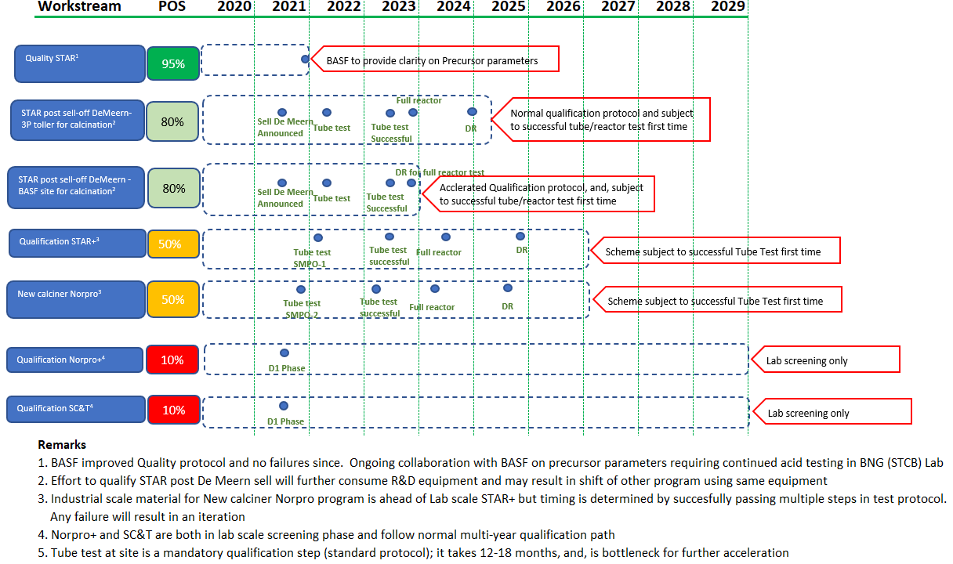
U600 Roadmap (Shell SMPO sites) – Original Plan
Need further acceleration
Need further acceleration

Slide 7
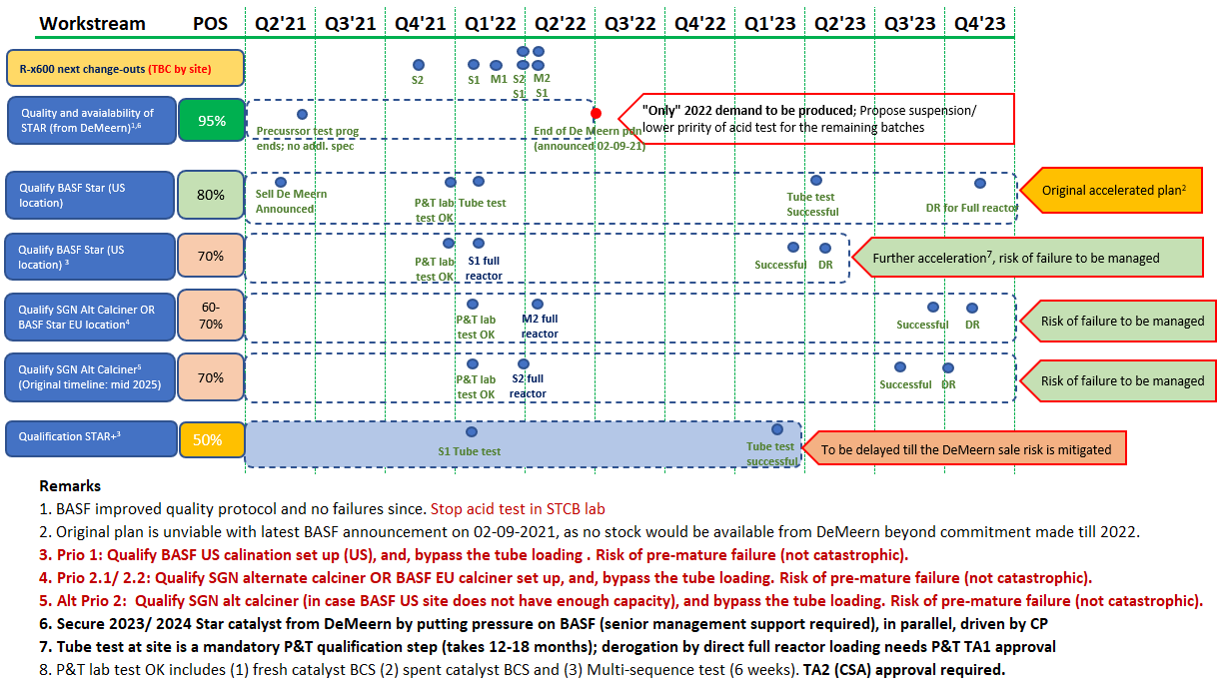
U600 Roadmap (Shell SMPO sites) – Accelerated Plan

Slide 8
Proposed way forward
A SM reactor cat change will stress our tank ullage as precursors accumulate due to throughput reduction during catalyst change period
  Typically it takes about 1 month to recover to normal tank levels for SM-1 cat change
  Bigger impact if going for a SM-2 reactor, thus not considered for trial
3 SM-1 reactor catalyst changes in Jan, Mar and Apr 2022
Propose to load a SM-1 reactor in Mar 2022 with trial catalyst from BASF
  This will minimize throughput reduction in case of immediate failure as there is a fresh reactor
Trials are not part of Capex planning
  Additional capex required to pay for the trial catalyst (US$536K for BASF; US$394K for SGN) on top of planned commitment
Qn: Are we able to load another SM-1 reactor with trial catalyst from SGN?

Slide 9
Risks
Risks | Likelihood | Consequences | Mitigations
Trial catalyst fails immediately | M | M (Econs) | Immediate cat change required → production loss, cost of additional cat change (US$142K) Spare normal catalyst available Lab testing by P&T before loading Both suppliers gave verbal proposal to provide 1 batch free upfront (payment on satisfactory performance)
Trial catalyst does not reach expected life | M | L (Econs) | Earlier cat change required → minimal production loss, cost of additional cat change Same as above
2 trial catalyst fail immediately | L | H (Econs) | Immediate cat changes required → higher production loss, cost of additional cat change (US$284K) Same as above
07 Sep 2021

Slide 10
Steer requested
Proceed with loading a SM-1 reactor in Mar 2022 with proposed mitigations
How to handle additional capex required?
Do we load another SM-1 reactor with trial catalyst from SGN if required?

Slide 11
Discussion and Q&A

