Slide 1
Project Title : PU2 - CD4 SCW network monitoring
Location/Unit: SEPL Bukom/ PU2 (CD4)
Champion: Ashvini Katkar (Tiger Team) along with PU2 Ops and tech
Project Engineer: Rina Yang
DPL ID/MTA ID: 211004 / Multiple
Date : 17/10/2022

Slide 2
High Level Summary for CD4 SCW project:
Selected option
Phase 1
 | Original Scope | Original Scope – Monitoring (Optimized) | Improved Monitoring Scope | Flushing + Monitoring | Do nothing
Capex, $mln | $2.5 – $3.0 | $2.0 – $2.5 | $0.5 | $0.6 | 0 (or defer to next TA)
Scope | Dead end flushing location (TA) Pumps + RO + stubs, boosted/non booster header (TA & non-TA) Basic monitoring PT/TT/FT (TA) | Dead end flushing location (TA) Pumps + RO + stubs, boosted/non booster header (TA & non-TA) | Basic monitoring PT/TT/FT + 10 x PT (TA) | Dead end flushing FT’s + max. 10 nos. Instruments | As is condition 2 existing booster pumps operating at edge of pump curve.
What it gives us | avoids salting to 3 HX (300k replacement cost each TA) Helps to a large extent to keep HDS3 HP mode operation Better Reliability of SCW network Much better mapping of SCW fouling for next TA | avoids salting to 3 HX (300k replacement cost each TA) Helps to a large extent to keep HDS3 HP mode operation Better Reliability of SCW network No monitoring capability. | Advanced monitoring of the network for better on the run-troubleshooting. | De-debris at E7540AB, E7541ABC, E7439AB. Much better mapping of SCW fouling for next TA | -
Potential consequence, if project is not executed. |  | Difficulty in monitoring & tuning the network. | Accept risk of CD4 potential OA loss (~ 1% annually) Loss of SCW booster pump means HDS3 operates on LP mode (tail gas to flare gas header, multiple thinned sections) Replacement of Ti HX due to salting of 300k per TA.
Notes:
1) Phase2 : Original scope optimized (option 2) to proceed ahead with engineering, so as to achieve FID by Apr 2023 (dependent on Wood availability, after TA 2023 works are concluded)
2) Temp MOC for running 2oo2 booster pump (P7540A/B) has to be converted to permanent. RE has confirmed 2oo2 pump reliable run cannot be assured. Mitigation be discussed as part of permanent MOC. Essential pump/ motor spares to be made available in case any of the pump fail in between (part of permanent MOC). Running both the booster pumps is critical to get sufficient SCW flow to HDS3 HEX’s to enable HP mode of operation. In case of pump failure, HDS3 will go into LP mode of operation.
3) To enable HDS3 LP mode operation, a repair strategy for the 2 flare headers (CD2/4, CD1/5) which needs to take into account redundant CD5 flare header, short term repairs/doability, into question (i.e. we should look beyond clamping thinned sections which require significant alternations to multiple pipe supports). Action is with Utilities Tech team.

Slide 3
Problem Statement – Phase 1
Insufficient monitoring of CD4 SCW network for pressure and flow
Marine debris accumulation at SCW supply header of elevated HEXs
Proposed solution – Phase 1
To install pressure and flow transmitters at critical location in SCW network
Dead end flushing arrangement to clean up accumulated debris
Notes:
E7525-100%
E7524-100%
E7508ABCD- 40%

Slide 4
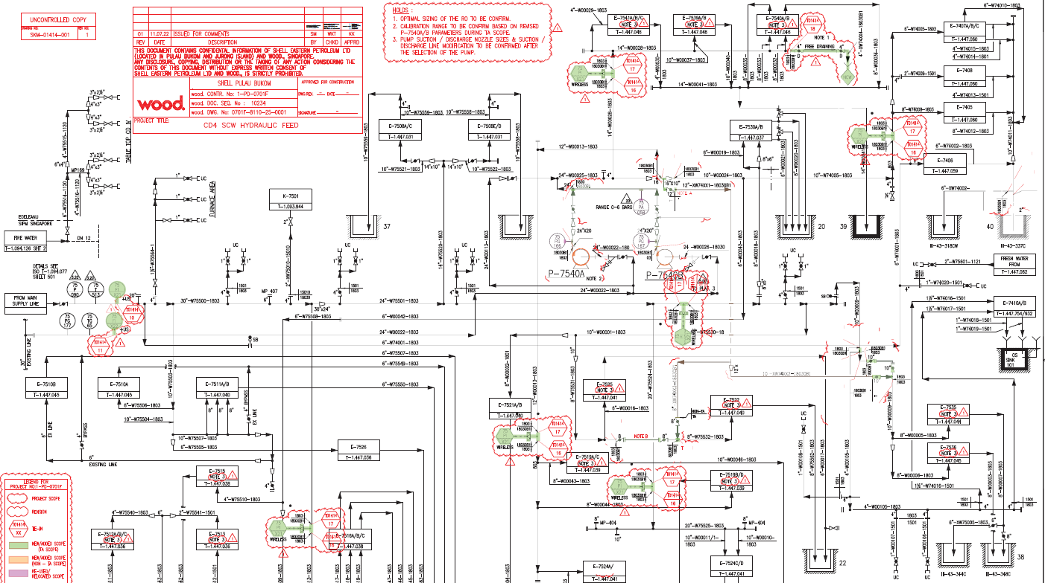
Scope summary – Phase 1
TA Scope (Green highlighted in screenshot):
Installation of instrumentation – 6 PTs, 2 FTs
SCW Supply dead end flushing set up

Slide 5
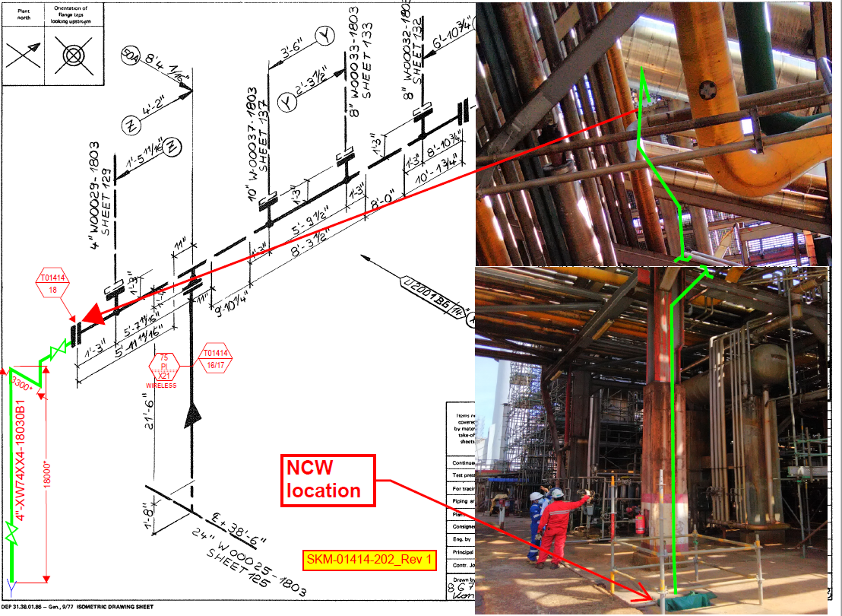
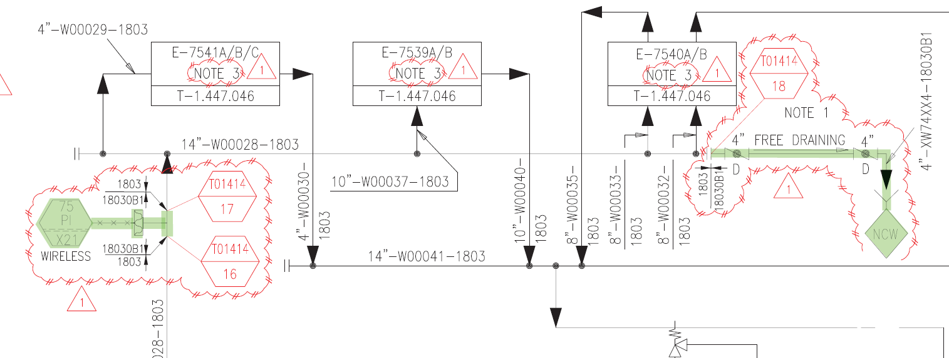
Scope of E7540A/B, E7539A/B, E7541A/B - SCW Supply Header Dead End flushing arrangement - TA Scope
Marine Debris usually collect at the end of header and can plug heat exchanger if agitated.
Header Dead End flushing setup. Similar has been done for ECC CW system.
DEAD END FLUSHING ARRANGEMENT - TA scope

Slide 6
Justification
Category
AI | C (Compliance)
 | HSE
 | R (Reputation)
 | CS (Internal Standards)
 | Justification
R A M |  | Rating
 | R+5Y
 | Yellow | Asset (D3)
 | Blue
VIR | 2.91
MM | REL (Reliability) | x
 | IR (Infrastructure Renewal)
 | MR (Margin Recovery)
GR | G (Growth)
There is dead end header on the supply side of the HEX’s E7540A/B, E7539A/B cluster. These dead end lead to accumulation of debris over a period of time. Once the debris is agitated due to change in flows, et al, pieces of these debris can go into the HEX’s and get stuck at the inlet of the tubes causing tube damages/ leaks in worse case scenario.
VIR is calculated based on estimated 2 weeks shutdown of CD4 due to unavailability of E7540A/B. Likelihood of debris entering causing failures has been taken as once in 20 years.
As per ENS CD4 S/D impact is loss of 27.4 mil /month ~13.5mln for 2 weeks.
Mark with X where applicable
Key in the following score for VIR / MTA / RAM
AIMM – MTA Scoring
AIMM – RAM Rating
GR & MM – VIR
Notes:
VIR will be more than 1

Slide 7
Change in cost
CAC @ End Select +/-30% USD $1,670K
------------------------------------------------------------------------------------------
PAC @ End Define +/-10% USD $813K
-----------------------------------------------------------------------------------------
Difference (Decrease) USD $857K
Phasing out of scope to post BBTA 2023 as per alignment meeting with BLT on 21 Sep 22

Slide 8
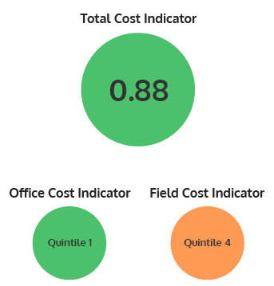
Cost Estimate : USD $813K (+/-10%)
------------------------------------------------------------------------------------------
Pre-funding USD $115K 14%
Engineering USD $48K 6%
Procurement USD $142K 17%
Construction USD $352K 43%
Overhead USD $90K 11%
Contingency USD $66K 8%
-----------------------------------------------------------------------------------------
Total Cost USD $813K 100%

Slide 9
Project LE phasing & Schedule
Funding Timeline
  220m of cable trenching to be executed post-TA
Capex Allocation | 2022 | 2023 | 2024 | Total
CAPEX (USD) | 50K | 387K | 261K | 698K
Define
(MTS)
Scope &
Specification
Define
Front End
Engineering
Development
Define
Full Funding
(FID)
Approval
Execute
Detail
Engineering
Execute
Procurement/Award
Sub-Contract
Execute
Construction
Operate
RFSU
Select
Pre-funding
Approval (PDR)
Mar 22
May 22
Jun to Sep 22
Oct 22
Nov 22 to
Feb 23
Oct 22 to
Jun 23
Apr 23 to
Mar 24
Mar 24

Slide 11
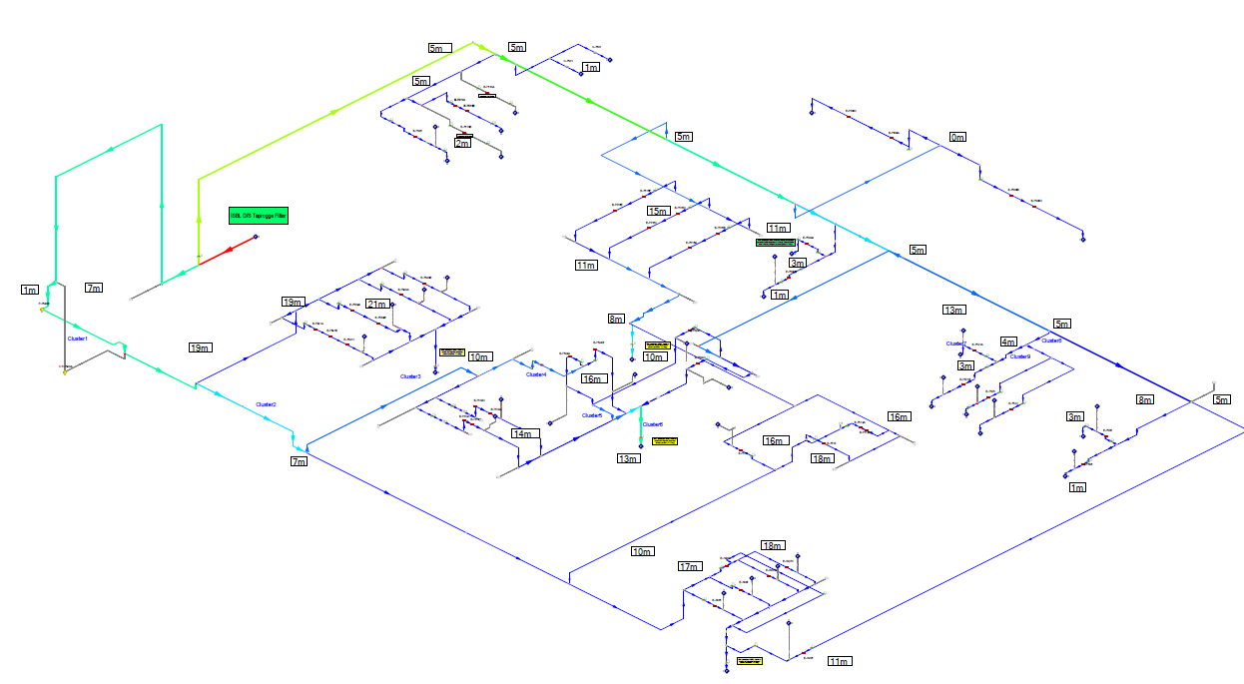
New additional pressure transmitters (PT) location
New additional PT on Non Boosted hdr
Existing PT location
75P090
HEX Failure- CD4100% Crude Impact CD4 Shutdown
HEX Failure- 40% Crude Impact (CD4 Slowdown)
HEX Failure- 20% Crude Impact (CD4 Slowdown)
HEX Failure- 10-15% Crude Impact (CD4 Slowdown)
(S) – Salting Probability HEX
New additional PT on Boosted hdr
E7511AB (S)-2m
E7516ABCDEF-15m
E7526 (S) -2m
Clamp-on Ultrasonic flowmeters
E7508ABCD (S)-2m
Non- Boosted Header
PT not required, to be removed
SCW Supply from PU6
Shift this PT as indicated
2 x 100%
SCW Booster Pumps
E7524AB -14m
E7524CD -14m
E7522 (S) -3m
Existing PT location on pump discharge
75PA058/75PG166/167
Boosted Header
E7515 – 15m
E7525 -3m
E7540AB-22m
E7539 - 22m
E7541A-21m
E7541BC-21m
E7512ABC -16m
E7513 -16m
E7536-1m
E7535 (S)-1m
E7405 (S) -17m
E7407ABC -18m
E7408 -18m
E7406-15m
E7519ABCD – 15m
Notes:
E7525-100%
E7524-100%
E7508ABCD- 40%

Slide 12
CD4 Heat Exchangers Threats:
Threat Title | MTO Score
I-0206523 (E7536) E7536 High risk of salting on SCW side based on SCW & process side flow/temp | 2,625,000
I-0206465 (E7540A/B,E7539A/B) High vacuum at SCW outlet for E7540AB,E7539,E7541ABC leading erosion in tubes | 125,000
I-0206478 (E7540A/B,E7539A/B) Risk of debris accumulation in the dead end header | 250,000
I-0206476 Lack of SCW flows in E7524 series HEX’s leading to debris accumulation | 2,625,000
I-0206473 Lack of flow instrumentation available to monitor the SCW network in CD4 | 125,000
I-0206472 Lack of temperature instrumentation available to monitor the SCW network in CD4 | 125,000
I-0206466 (E7511A/B) High risk of salting on SCW side based on SCW & process side flow/temp condition | 250,000

Slide 13
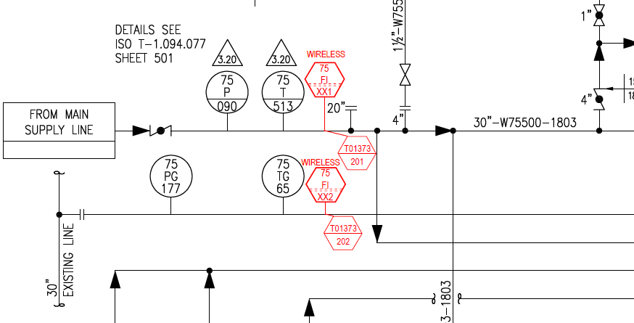

Improved Monitoring of SCW headers- TA Scope
Installation of FT on SCW main headers
Installation of PT on SCW headers

Slide 14
Complete Scope for CD4 SCW network (Phase 1 + Phase 2)
Phase 1 scope – CD4 TA 2023 scope
Phase 2 scope – Post TA scope
Non- Boosted Header
Pumps head increase
Pumps discharge line size increase
4m long line size reduction to 16”
SCW Supply from PU6
Line demolition scope
2 x 100%
SCW Booster Pumps
E7524AB -14m
E7524CD -14m
E7522 (S) -3m
E7540AB-22m
E7539 - 22m
E7541A-21m
E7541BC-21m
8”
E7536-1m
E7535 (S)-1m
Header Dead end flushing
Boosted Header
12”
10”
Network Monitoring (FT, PT)
12”
12”
RO + Valve on SCW outlet lines
E7405 (S) -17m
E7407ABC -18m
E7408 -18m
E7406-15m
New lines to shift 3 HEX tap off from non boosted to boosted header
Network Monitoring (PT, TT)
Hydraulic model assessment and Revised scope is based on removal of existing RO at supply of E7519 AB and CD
Also as confirmed with Ops there is no RO on SCW supply for E7524AB on boosted network
Notes:
E7525-100%
E7524-100%
E7508ABCD- 40%

