Slide 1
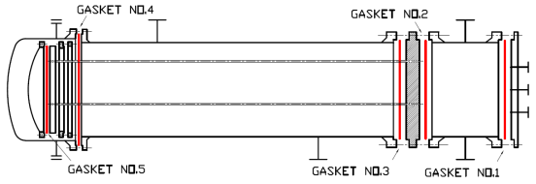
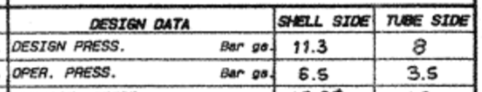
E224

Slide 2

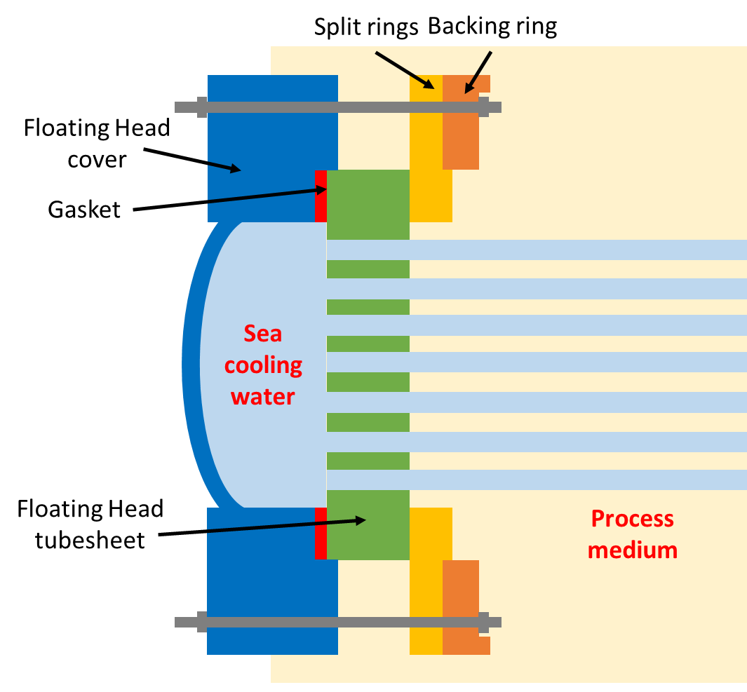
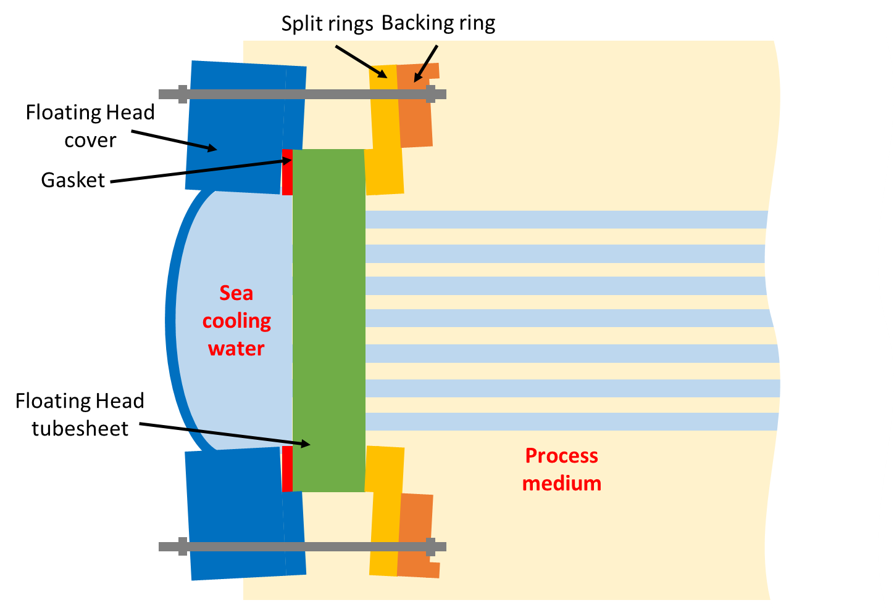
Small opening at floating head
Normal Situation
Current Situation

Slide 3
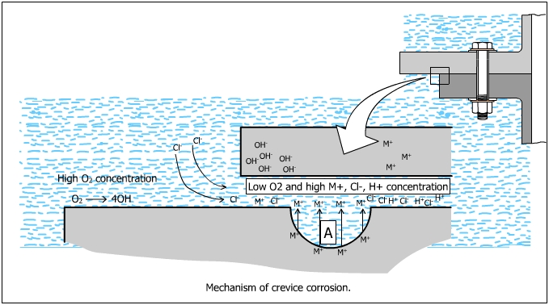
Crevice Corrosion
Anodic reaction:
O₂ + H₂O +4e → 4OH⁻
Cathodic reaction:
2Fe → 2Fe²⁺ + 4e
Inside crevice:
2Fe²⁺ + 4Cl⁻ → 2FeCl₂
2FeCl₂ + 2H₂O → Fe(OH)₂ + 2HCl

Slide 4
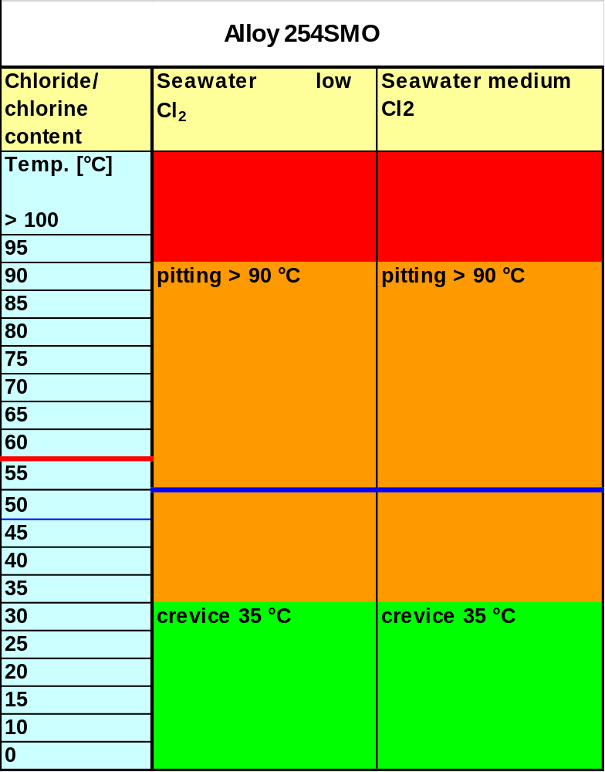
Crevice Corrosion Critical Temperature

Slide 5
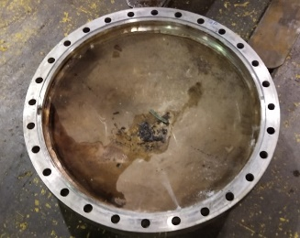
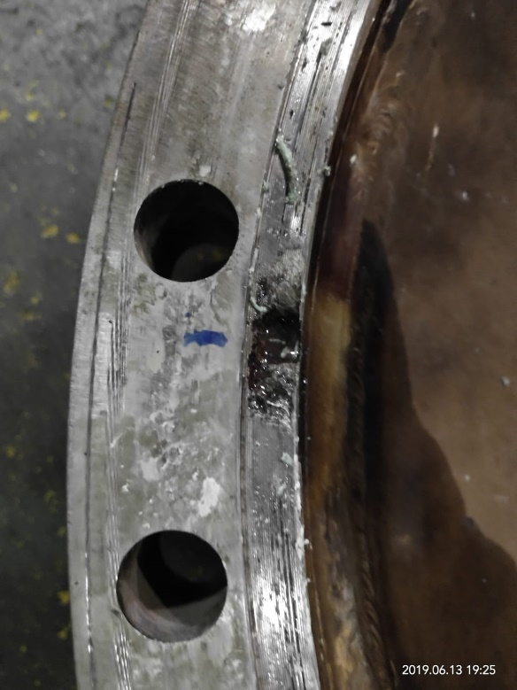
Crevices at Floating Head Cover
1
4
19
5
18
9
10

Slide 6
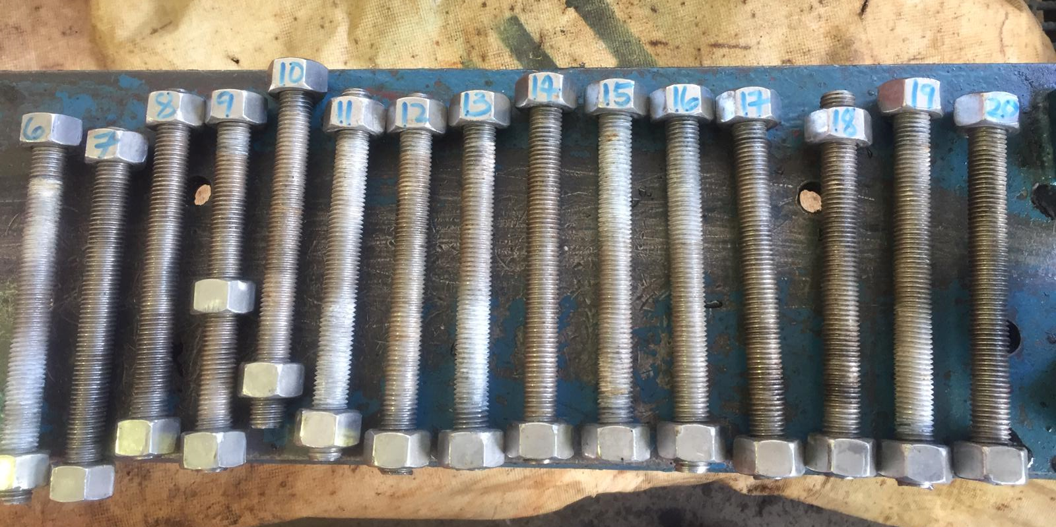
Plastically deformed bolts
IDENTIFIER |  | THICKNESS (mm) | Remarks
 |  | 19th July 2019
E-224 Bolt | Bolt-01 | 197.32 | B8SH
 | Bolt-02 | 197.01 | B8SH
 | Bolt-03 | 197.24 | B8SH
 | Bolt-04 | 197.10 | B8SH
 | Bolt-05 | 197.04 | B8SH
 | Bolt-06 | 201.64 | B8
 | Bolt-07 | 202.68 | B9
 | Bolt-08 | 201.56 | B10
 | Bolt-09 | 201.94 | B11
 | Bolt-10 | 201.89 | B12
 | Bolt-11 | 200.58 | B13
 | Bolt-12 | 208.21 | B14
 | Bolt-13 | 201.01 | B15
 | Bolt-14 | 202.60 | B16
 | Bolt-15 | 201.46 | B17
 | Bolt-16 | 201.18 | B18
 | Bolt-17 | 201.85 | B19
 | Bolt-18 | 200.77 | B20
 | Bolt-19 | 200.85 | B21
 | Bolt-20 | 201.94 | B22
 | Bolt-21 | 201.97 | B23
 | Bolt-22 | 201.83 | B24
 | Bolt-23 | 201.58 | B25
 | Bolt-24 | 203.01 | B26
 | Bolt-25 | 201.95 | B27
 | Bolt-26 | 207.72 | B8M
 | Bolt-27 | 197.40 | B8SH
 | Bolt-28 | 198.41 | B8SH

Slide 7
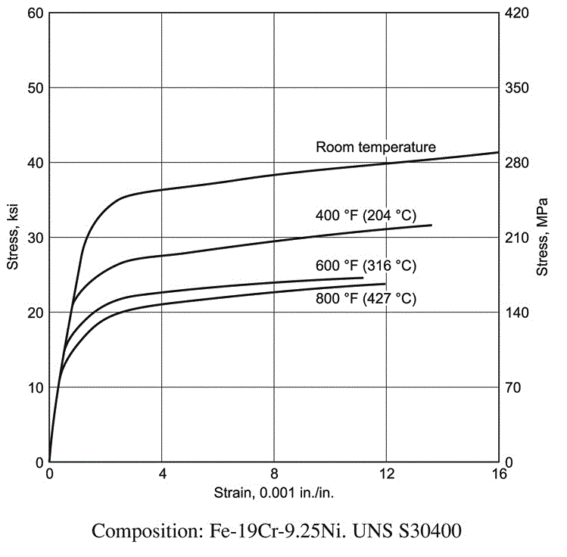
Stress-Strain curve

Slide 8
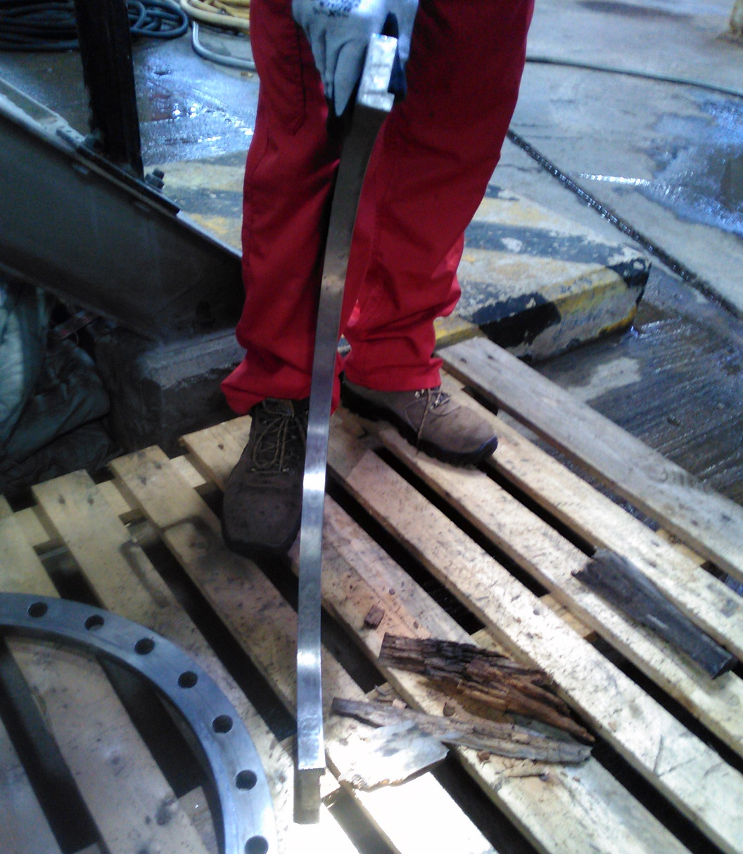
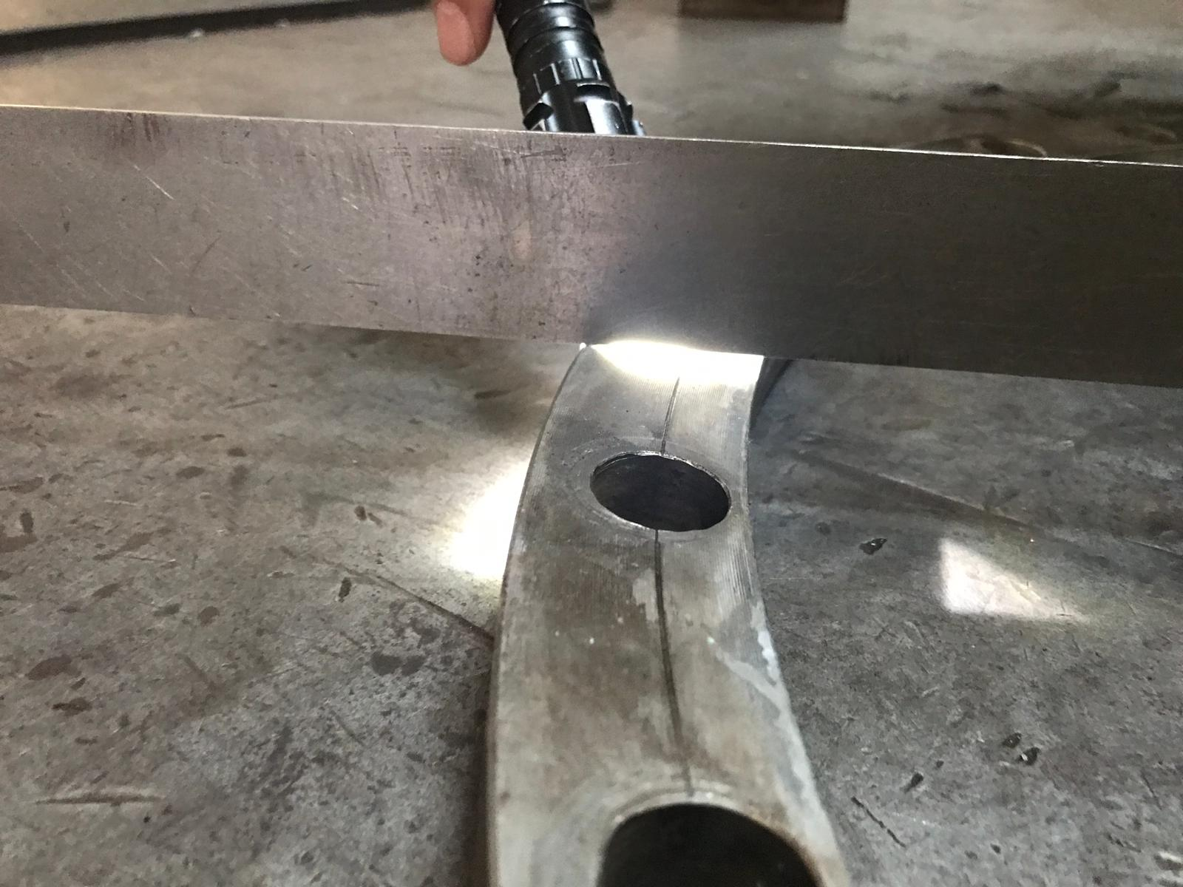
Deformed split rings and backing ring

Slide 9
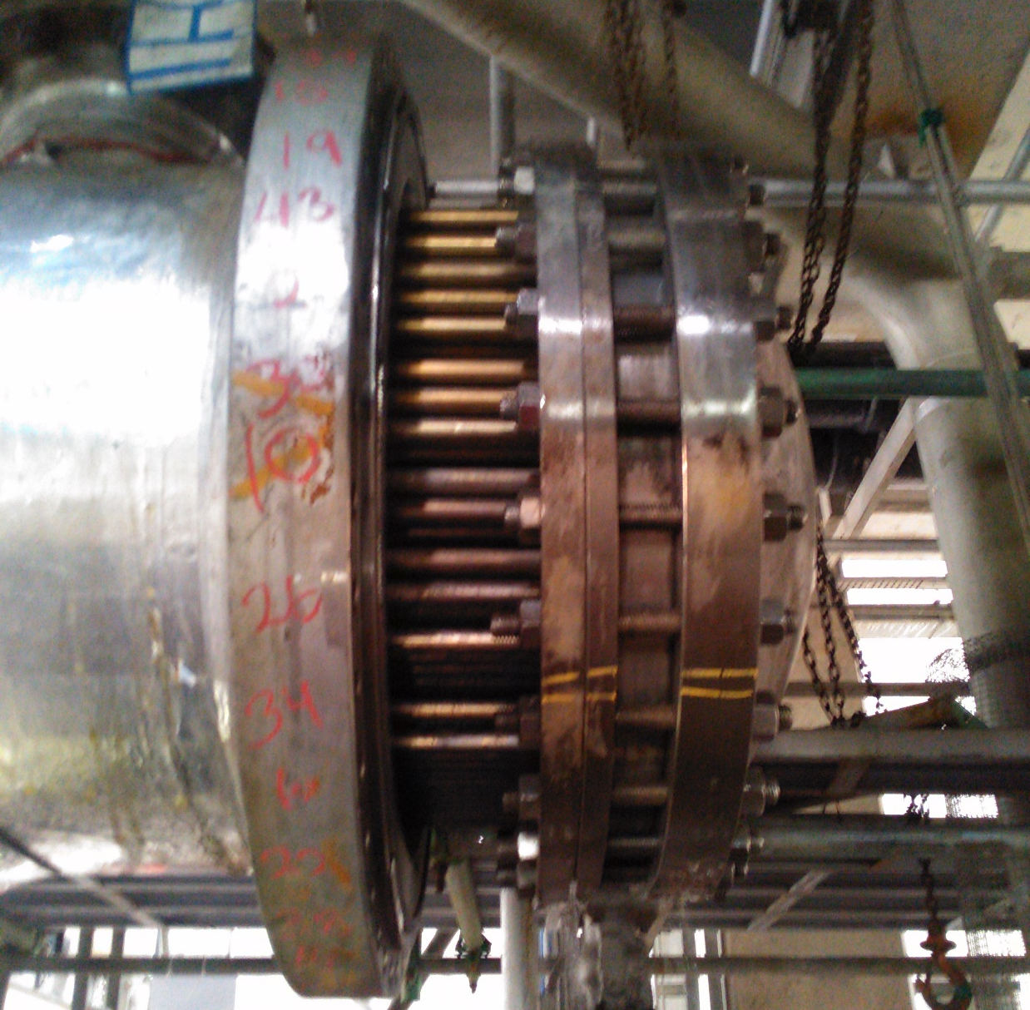
Paint marking at split rings and backing ring

